Slide 1

Importance of Riparian Buffers in Restoration of Barnegat Bay
Stephen J. Souza, Ph.D.

Slide 2
What We’ll Cover
What's a riparian buffer? Legal and environmental definitions
The Ecological Functions (environmental benefits) of riparian buffers
The Ecological Services (societal benefits) of riparian buffers
Examples of riparian buffer restoration

Slide 3
What We Won’t Cover
How to delineate a stream’s riparian buffer in accordance with the Flood Hazard Control Act Rules 7:13.
Various factors and conditions that define the width of the riparian buffer.
What activities are allowed within the riparian buffer and various enabling regulatory permits.

Slide 4
EPA’s Definition of Riparian Area¹
“Vegetated ecosystem along a waterbody through which energy, materials and water pass”.
  Combination of wetlands and uplands
  Includes floodplain and some transitional uplands
“Riparian buffer part of Riparian Area”…land adjacent to a stream.
A natural filter that removes various non-point source pollutants as well as mitigate flood related impacts.
USEPA 2005. National Management Measures to Protect and Restore Wetlands and Riparian Areas for the Abatement of Nonpoint Source Pollution. EPA 841-B05-003.
Tjaden and Weber 1998. Riparian Buffer Management, Fact Sheet 174, Maryland Cooperative Extension

Slide 5
NJDEP Definition of Riparian Zone as per NJAC 7:13
A buffer adjacent to a surface water (streams, lakes, and rivers).
Varies in width…50, 150, or 300-ft wide along both sides of the waterway; width function of the waterway’s classification (NJAC 7:9B).
Almost every waterway that collects runoff from at least 50 acres of land possesses a riparian zone.
Any naturally occurring stream with a discernible channel possesses a riparian zone, no matter how small the area that drains to the stream.

Slide 6
General Schematic of Stream, Flood Plain and Riparian Buffer
Uplands
Flood Plain
Stream Channel
Flood Plain
Uplands
EPA 2010 – Guidance for Federal Land Management in the Chesapeake Bay Watershed, Chap 5, Riparian Area Management EPA841-R-10-002

Slide 7
Ecological Services and Functions
Ecological Services – Attributes that yield “societal/ cultural” benefits.
Ecological Functions – Attributes that yield “environmental or ecosystem” benefits.
Ecological services and functions of forested riparian buffers and headwater riparian buffers especially significant (Klapproth and Johnson. 2009. VPI, Publication 420-152 & Kaplan, et. al. 2008. Protecting Headwaters, Stroud Water Research Center)

Slide 8
Ecological Services and Functions of Riparian Buffer
Services (Societal)
Flood mitigation and resiliency
Stream aesthetics
Passive recreation
Active recreation
Passive treatment of NPS pollution
Clean water
Functions (Environmental)
Nutrient assimilation
Stream corridor stability
Temperature control
Aquatic and semi-aquatic species habitat
Stream and wetland biodiversity
Organic material

Slide 9
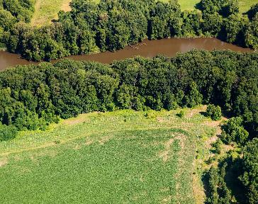
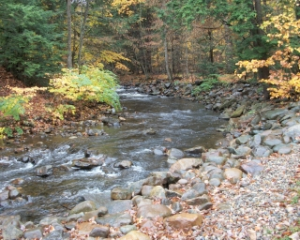
How Does A Riparian Buffer Function?
Chesapeakebay.net
LGPC.ny.gov

Slide 10
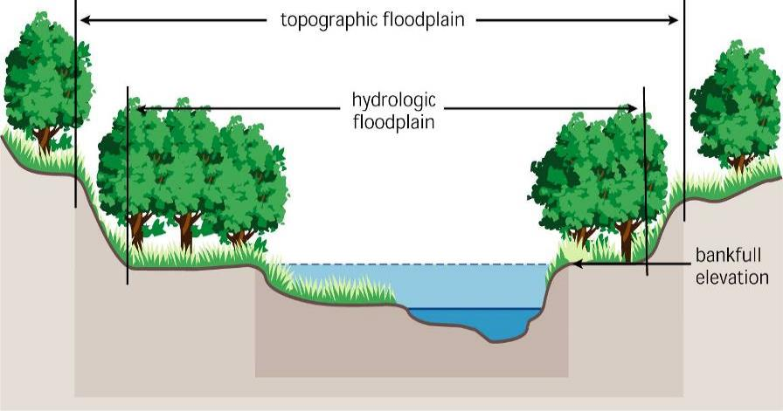
Undisturbed Floodplain and Riparian Corridor
Riparian Corridor
Stream Corridor Restoration: Principles, Processes, and Practices USDA 2008

Slide 11
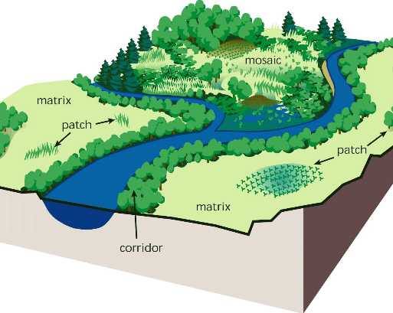
A Non-Impaired, Riparian Stream Corridor
Stable
Dissipates energy
Controls flooding
Intercepts pollutants
Facilitates recharge
Provides multiple types of habitats
Highly resilient to storm flows
Stream Corridor Restoration: Principles, Processes, and Practices USDA 2008

Slide 12
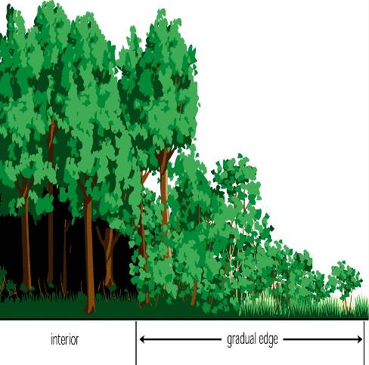
Loss of Stream Channel Resiliency
Often triggered by basic clearing, filling or alteration of riparian vegetation.
Ecosystem becomes less stable.
Results in ecological impairments to adjacent waterway.
Stream Corridor Restoration: Principles, Processes, and Practices USDA 2008

Slide 13
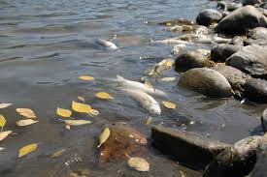
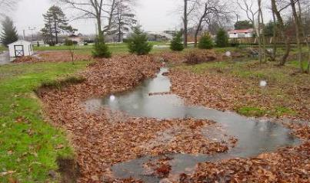
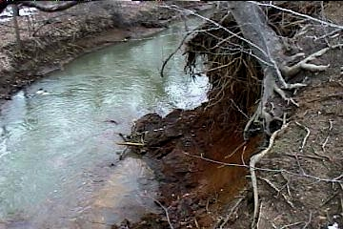
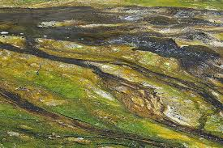
Evidence of Damaged Riparian Buffer

Slide 14
How Land Development Impacts Riparian Buffers
Altered hydrology (too much or too little water)
Altered hydraulics (increased flow rates)
Physical damage (clearing and filling)
Disturbance increases invasive plant colonization
Increased water temperature due to clearing and various types of discharges
Impacted water quality (increased pollutant loading)
Ecological impacts (result of all of the above)
Societal impacts (result of all of the above)

Slide 15
“What Goes Around Comes Around”
Watershed Development
Clearing and Filling
Loss of Ecological Services and Functions
Altered Hydrology, Erosion, Thermal Pollution
Degraded Water Quality and Habitat
Increased NPS Pollution

Slide 16
Fishery Impacts
Impaired riparian buffers directly linked to compromised fishery
Loss of canopy increases heating of stream, leading to thermal impacts and altered biological community
Loss of canopy and riparian vegetation affects availability and diversity of food¹ , aquatic insects…critical for young fish
Decreased woody debris habitat used by fish, invertebrates and amphibians
Decreased stream bank stability = more sedimentation = occluded/ smothered fish and aquatic insect habitat
Increased rate of eutrophication
Decreased baseflow due to loss of flood storage
1 – L. Albertson, V. Ouellet and M. Daniels. 2018. J Freshwater Ecol. 33:1, 195-201

Slide 17
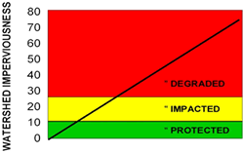
Watershed Development and Stream and Riparian Area Degradation
Degraded
Impacted
Stable
As per Schueler, 1992

Slide 18
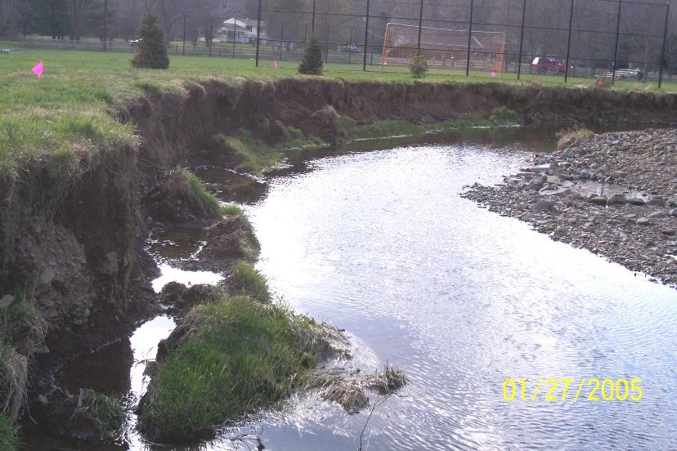
Here’s What a
Little Bit of Runoff Can Do!

Slide 19
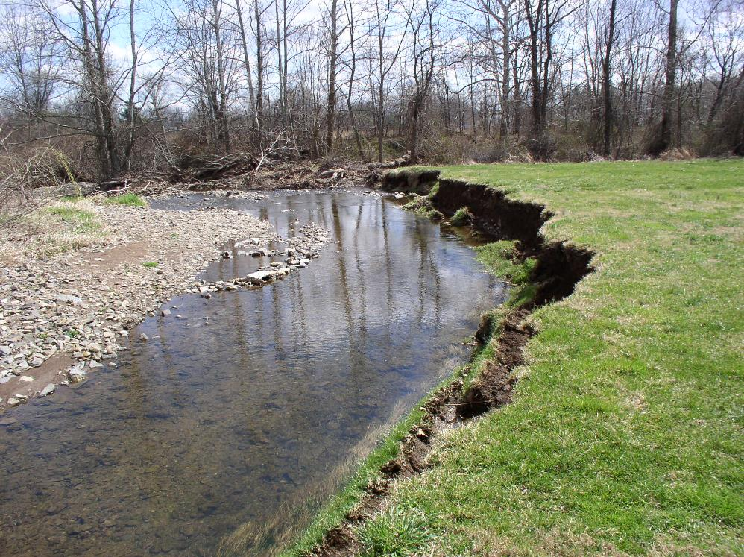
Notes:
Meander #1 was a vertical bank just behind the backstop of a ballfield. A hiking/running trail paralleled the stream in close proximity.
Flow did not go out of bank in this bend until it entered the woods.

Slide 20
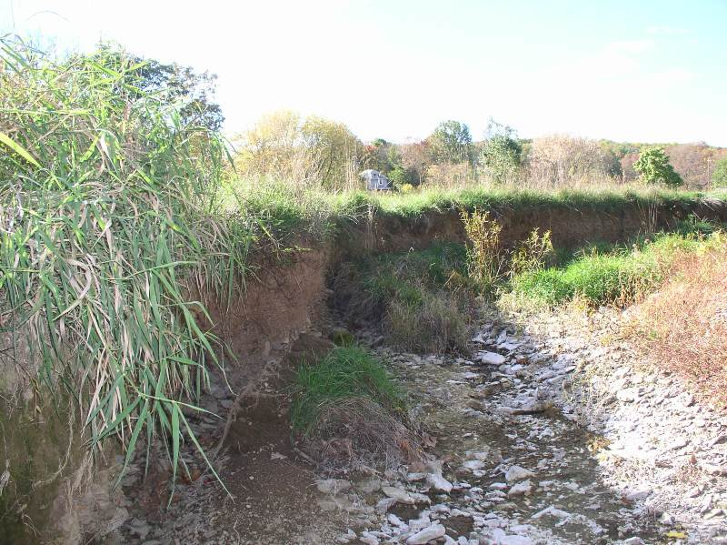
Notes:
Deep and severely cut banks

Slide 21
How To Avoid These Problems
Do not fill or disturb riparian buffers.
Do not remove vegetation or mow down riparian buffers.
Practice good stormwater management…reduce volume of runoff, promote recharge and mitigate peak flow related impacts.
Protect canopy.
Replace invasive species with native species.
Deer management.

Slide 22
Restoration Design
With correct data in-hand, proceed with a design that stratifies restoration goals and is sustainable…work with site and with nature.
Important not to “force fit” a solution. Make sure that the solution is backed by technically strong data.
Overall, the design needs to make sense from an ecological perspective and is consistent with site characteristics and natural attributes.
Too often the projected end-result is not in keeping with native conditions. Decreases success and sustainability of restoration effort.

Slide 23
In Summary
Riparian buffers provide a variety of ecological services and functions.
Importance of riparian buffers reflected in rules and laws that protect these areas from disturbance.
Importance of riparian buffers reflected in scientific literature.
Value of riparian buffers often underestimated.
Relationship to healthy, vibrant stream ecosystem misunderstood.

Slide 24
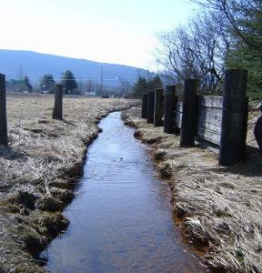
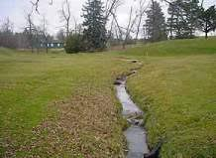
In Summary
Riparian buffers subject to wide array of impacts:
  Agriculture
  Logging
  Land development
  Land maintenance (mowing and clearing of vegetation)

Slide 25
In Summary
What can be done to promote healthy riparian buffers:
  Don’t fill or disturb riparian buffers.
  Don’t remove or mow down riparian vegetation.
  Practice good stormwater management…reduce runoff volume, recharge, and mitigate peak flow related impacts.
  Protect and enhance riparian tree canopy.
  Replace invasive species with native species.
  Control and manage deer.

Slide 26
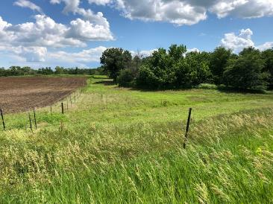
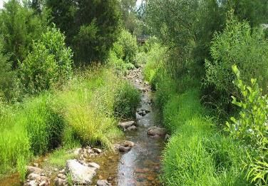
In Summary
Sustainable riparian restoration entails “designing with nature”
Based on “solid” physical, hydrologic, hydraulic, geomorphic data
Reflects understanding of native ecology

Slide 27
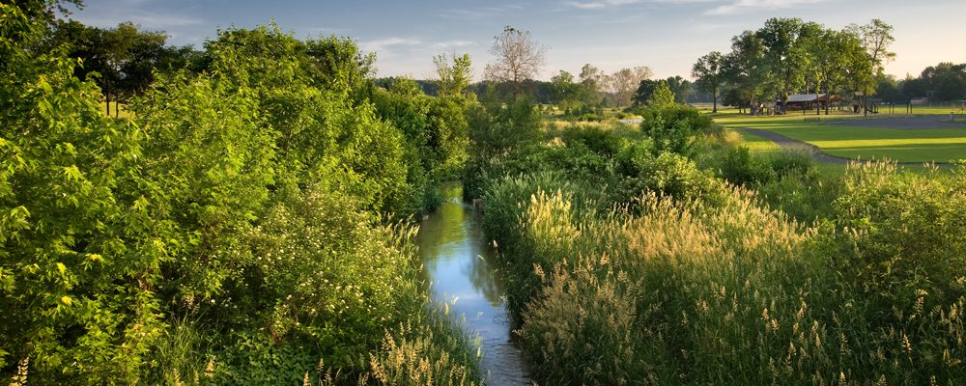
In Summary
A Healthy Riparian Buffer =
A Healthy Stream
Healthy Streams = Healthy Barnegat Bay

Slide 28

Thank You
Stephen J. Souza, Ph.D.

