Slide 1

Porous Pavement Applications For Barnegat Bay Watershed
A Gray/Green Infrastructure Technique
Stephen J. Souza, Ph.D.

Slide 2
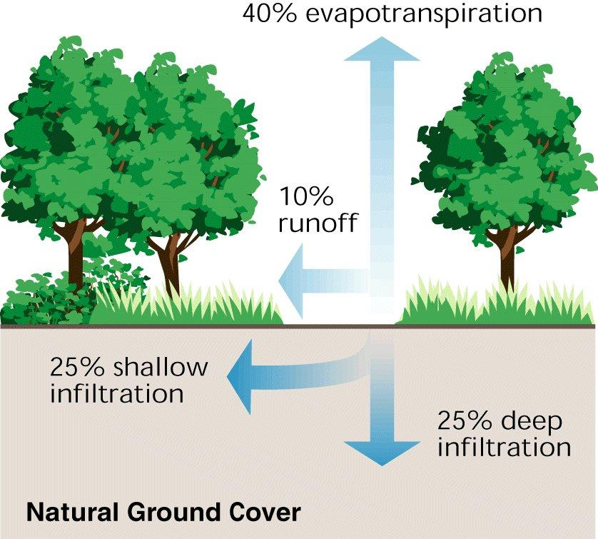
Hydrology of Undeveloped Watershed

Slide 3
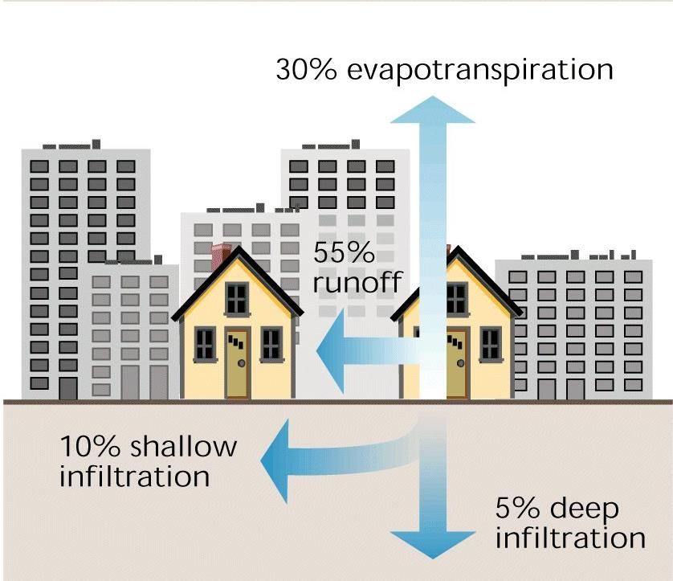
Hydrology of Developed Watershed
10%-20% Impervious Cover

Slide 4
What’s A Green/Gray SW BMP?
Gray Stormwater BMPs – Standard techniques used to collect, route and “manage” stormwater runoff...Focus on collect, detain and discharge.
Green Stormwater BMPs – Wide array of SWM practices used to collect, retain, reuse, infiltrate and passively biologically treat runoff... Focus on reducing runoff volume, maximizing runoff recharge, and removing pollutants.
Green/Gray Stormwater BMPs – Hybrid stormwater runoff management...incorporates some of both gray and green techniques.
Scalable - Very applicable for lake communities…new or retrofit applications for individual lots, parking lots, boat launch, walkways, clubhouse parking lot, etc.

Slide 5
Overview of Porous and Permeable Pavement

Slide 7
What’s Porous/Permeable Pavement?
Paving material with functional and structural support properties similar to conventional pavement.
Paving material with “pores” that facilitate the passage of stormwater through the pavement's surface.
Net positive effect
  Reduced runoff volume
  No loss in function as a stable, paved surface
Used in Europe for close to 50 years.

Slide 8
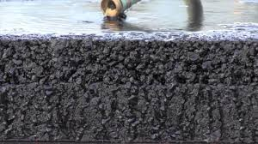
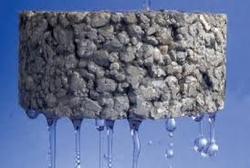
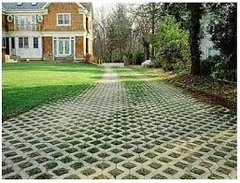
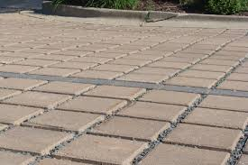
Types of Porous/Permeable Pavement
Porous concrete
Porous asphalt
Pervious pavers (PICP)
Eco-pavers

Slide 9
More runoff
Runoff generated faster
More contaminant mobilization & transport
Less runoff, runoff rate slower
More chance for recharge
Less contaminant transport
Conventional Versus Permeable Pavement

Slide 10
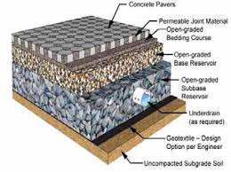
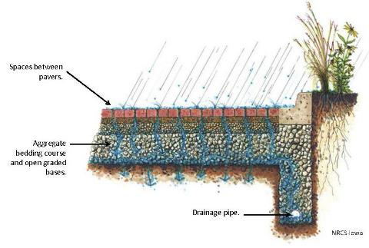
Permeable Surface With Under Drain

Slide 11
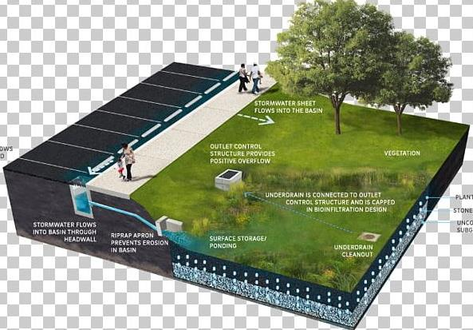
Permeable Pavement W/ Bio-detention
https://imgbin.com/png/pGehbEUb/bioretention-stormwater-retention-basin-permeable-paving-pond-png

Slide 12
Shared Construction/Installation Attributes
From: ASCE Permeable Pavement Manual

Slide 13
From: USDOT – FHA / FHWA-HIF-15-009, 2015

Slide 14
Permeable/Porous Pavement - Pros
Less runoff – reduced flooding, pollutant loading, size of ancillary BMPs
Reduces urban ‘heat island’ effect.
Less “slip / trip”...safer surfaces.
Applicable for various scale projects.
Some produced using recycled materials.
Service life similar to conventional pavement.
LEED credits.
Can be used in cold/warm climates.
More attractive than standard paving.

Slide 15
Permeable/Porous Pavement - Cons
Public acceptance
May be more expensive than conventional surfaces.
Special maintenance to prevent clogging.
In high traffic areas may not provide longevity of conventional surfaces.
Special considerations w high water table and sub-soils subject to shrink/swell or frost heave.
Lack of skilled experienced contractors.
Acceptance by municipal engineers (see #1 and #2 above).

Slide 16
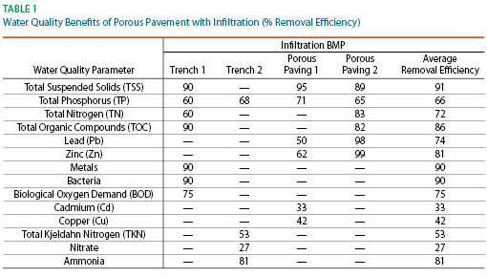
Possible Water Quality Benefits
Source - https://www.asphaltpavement.org – National Asphalt Pavement Assoc.

Slide 17
Comparative Costs
Material costs generally 10%-20% greater for permeable pavements compared to nonpermeable pavements.
Base excavation and preparation costs typically similar and in some cases less for permeable pavements.
Some cost offsets may be realized due to greater infiltration and less runoff; decreases need/size of ancillary detention basin.
Maintenance costs are greater for permeable pavements.
Accounting for added SW mgmt. costs, permeable pavements are more economical over 20-year and 30-year cycles¹.
1 – Rehan, Qi and Werner. 2018. Life-Cycle Cost Analysis for Traditional and Permeable Pavements, Construction Research Congress 2018

Slide 18
Types of Porous and Permeable Pavement

Slide 19
Permeable or Porous Asphalt
https://www.unh.edu/unhsc/sites/unh.edu.unhsc/files/pubs_specs_info/unhsc_pa_spec_10_09.pdf

Slide 20
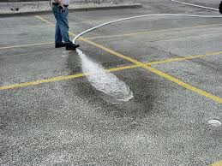
Porous Asphalt Specs
National Asphalt Pavement Association (NAPA).
USDOT Federal Highway Admin
Various Departments of Transportation (DOT).

Slide 21
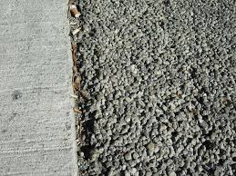
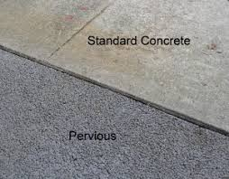
Permeable Concrete
High porosity concrete.
Allows passage of rainfall from surface to sub-soils.
Minimizes runoff and promotes recharge.
Rougher surface may limit some applications.

Slide 22
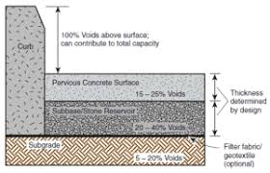
Design, Installation and Maintenance Specifications
USDOT – FHA
Multiple State DOTs
Pervious Pavement.Org
Concrete Network

Slide 23
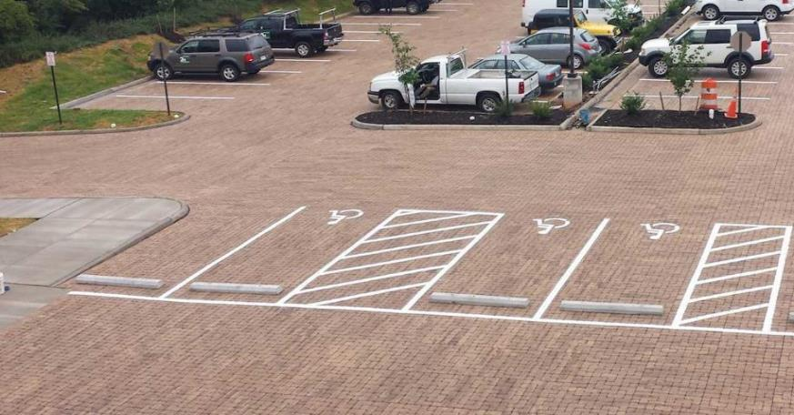
Permeable Pavers
SWM Pave – SWMPave.Com

Slide 24
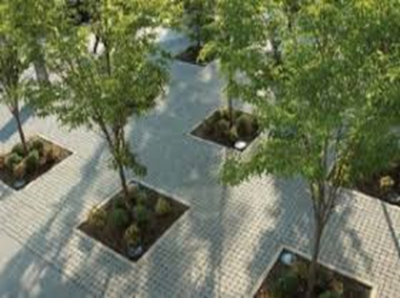
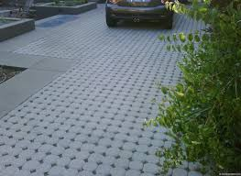
Permeable Pavers
Used in variety of applications – patios, parking lots, driveways.
Require proper subsurface preparation.
Typically, cheaper than concrete but may be slightly more expensive than macadam.

Slide 25
Case Study -
Toms River Board OF Education
American Littoral Society

Slide 26
Toms River BOE Offices
Infiltrate runoff from southwest parking lot.
Retrofit 8 parking stalls from conventional macadam to porous pavement.
Portland cement and open-graded aggregate. The aggregate material below the paved area stores and detains runoff.
Post-installation infiltration rate > 10”/hour; greater than the 500 yr event.
Total cost ~ $20,000.

Slide 27
Existing Conditions
Construct ancillary rain garden to treat and infiltrate any excess runoff
Remove macadam from 8 parking stalls.
Repave w porous concrete

Slide 28
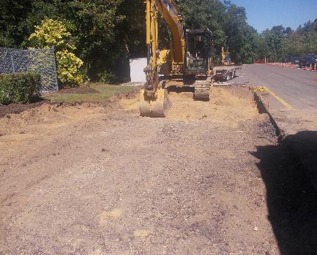
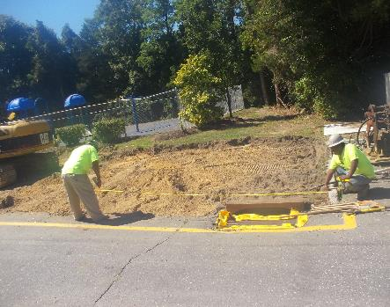
Remove Macadam and Prep Base

Slide 29
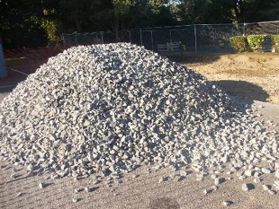
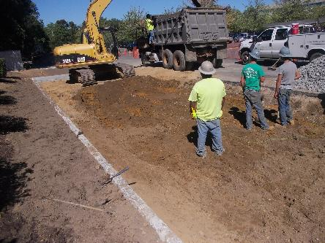
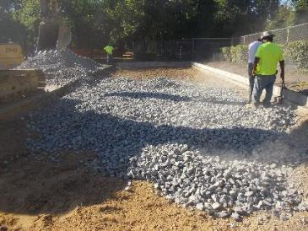
Final Prep and Install Sub-Base

Slide 30
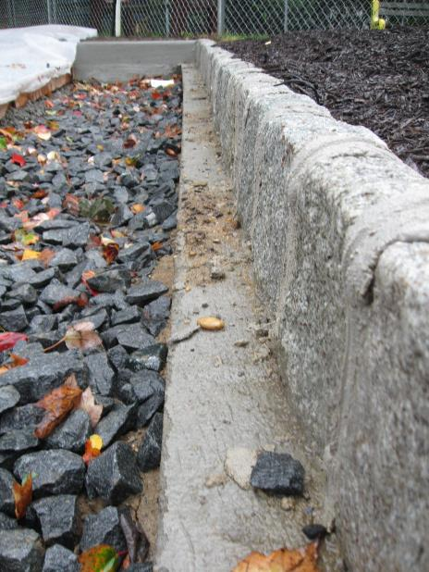
Overflow Underdrain System

Slide 31
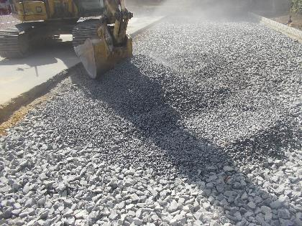
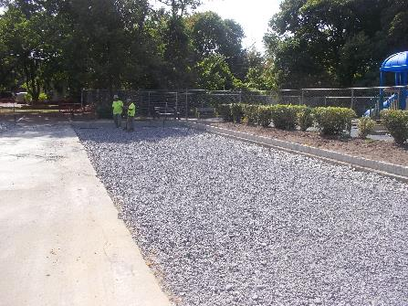
Final Porous Concrete Sub-Base

Slide 32
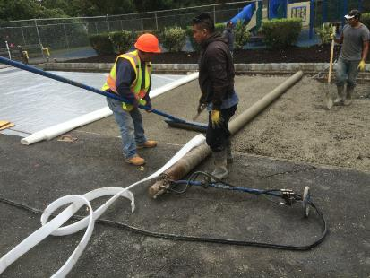
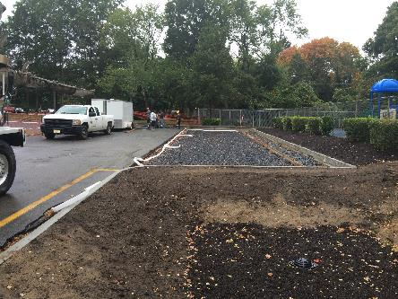
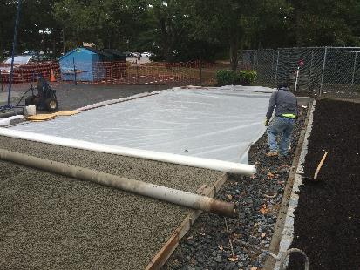
Pouring of Porous Concrete Surface

Slide 33
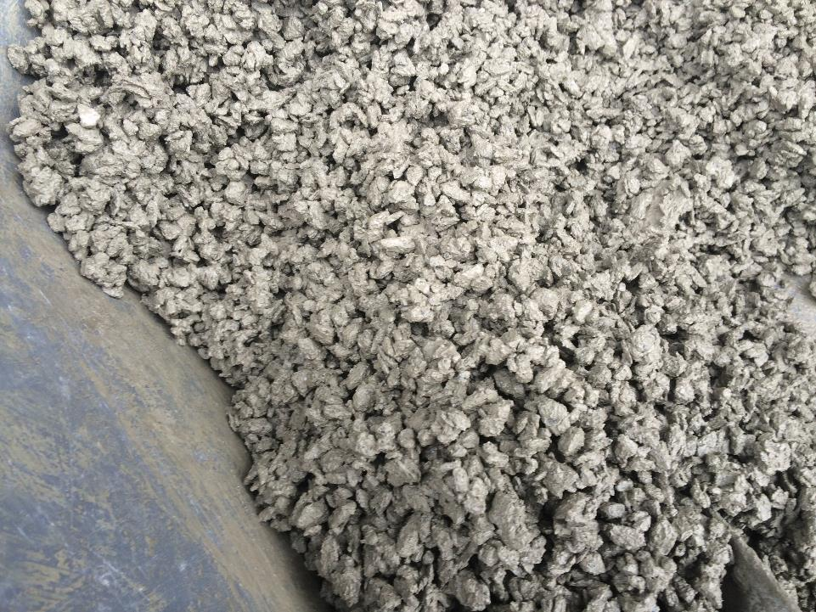

Slide 34
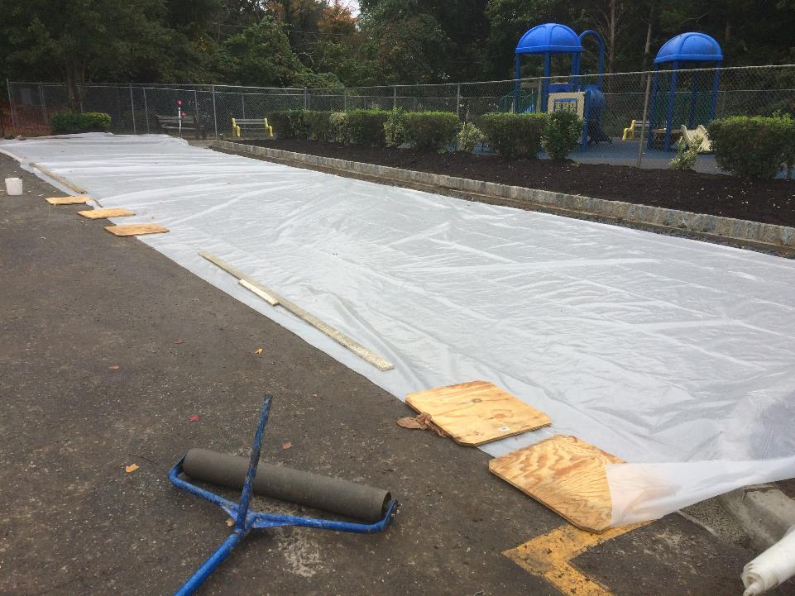
Porous Concrete Surface Set & Curing

Slide 35
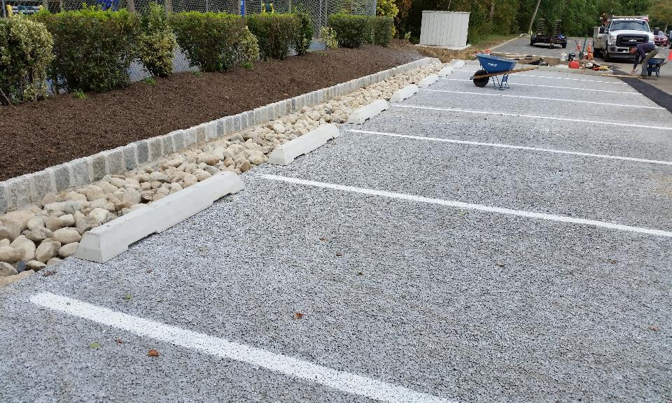
1 week Following Installation

Slide 36
2 Months After Installation

Slide 37

Toms River BOE Offices WQ Improvements
System capable of infiltrating 500-year event, as based on in-field infiltrometer testing.
Modeled pollutant removal
  95% decrease in TSS.
  80% decrease is TP
  80% reduction TN.

Slide 38
Maintaining
Pervious and Porous Pavement

Slide 39
Preventive Maintenance
Inspect on a regular (monthly) basis to ensure no standing water, accumulated debris or physical damage.
Don’t use sand, grit, etc. for ice control...usually not needed due to infiltration of precipitation / snow melt.
Train crews to avoid snow plow damage...equip plows with rollers.
Immediately remove tracked mud.
DO NOT apply any type of seal coating...use specialized paint to delineate parking stalls, etc.

Slide 40
Basic Maintenance Requirements
Bi-annual inspection of surface for cracking, subsidence, spalling, deterioration, and erosion.
Remove unwanted vegetation.
Vacuum sweep surface four times annually.
Power wash to address clogged areas; use <500 psi & direct water at angle of ≤30 degrees
For permeable pavers follow manufacturer’s requirements and pay attention to condition of vegetative cover.

Slide 41
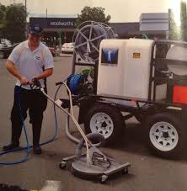
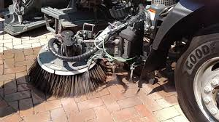
Specialized Maintenance Equipment

Slide 42
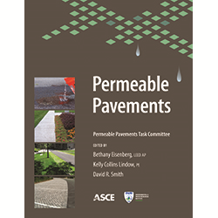
Plenty of Maintenance Guidance
https://sp360.asce.org/PersonifyEbusiness/Merchandise/Product-Details/productId/233129065
https://www.pwdplanreview.org/upload/pdf/SMP_Maintenance_18.06.04_Porous_Pavement.pdf

Slide 43
Summary
Alternative paved surface part of lake community SW strategy...small and large scale applications
Significantly reduces runoff volume, helps prevent flooding, decrease pollutant loading and increase infiltration.
Various applications, even high-use roadways.
Requires staff training, special maintenance and more frequent inspection.

Slide 44

Questions
Stephen J. Souza, Ph.D.

