Slide 1
Floating Wetland Islands What, Why and How
Stephen J. Souza, Ph.D.

Slide 2
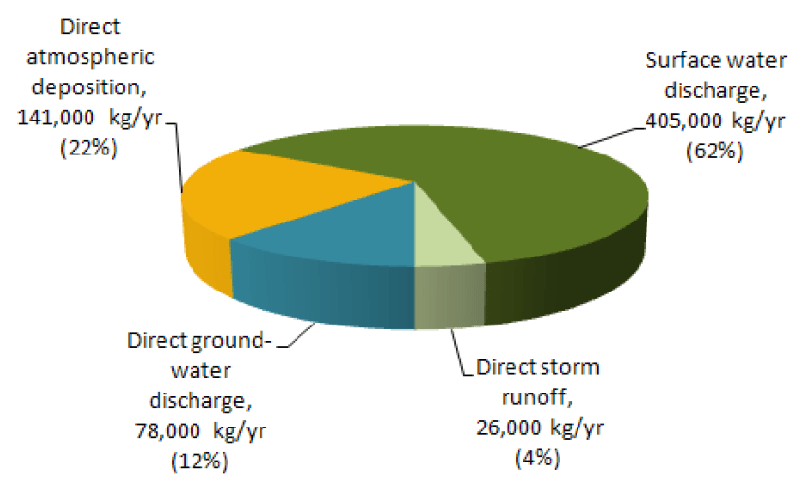
Nitrogen Loading to Barnegat Bay
Wieben and Baker, USGS 2009 and 2014

Slide 3
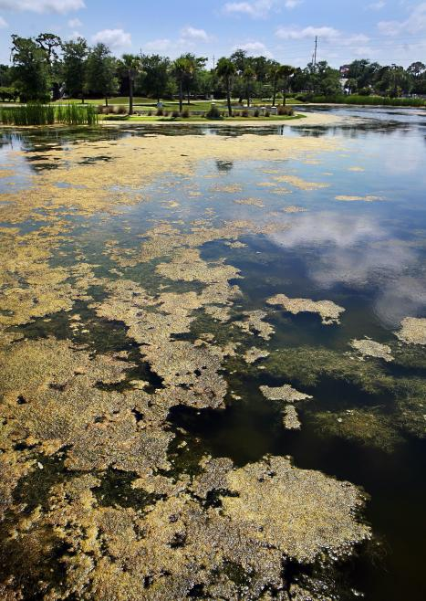
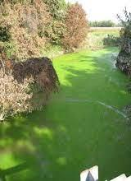
SW Pond
Stream
Photo- SeaGrant
Photo- USGS

Slide 4
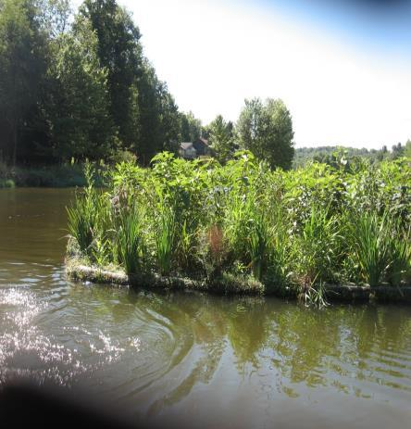
Floating Wetland Islands
Floating planting beds
Replicate nutrient and sediment removal achieved via wetlands and riparian buffer
Also provides fish habitat, shoreline erosion protection and added aesthetics

Slide 5
Possible Use Within Barnegat Bay Watershed
Part Of Nutrient Control Toolbox
Natural lakes and ponds
Agricultural ponds
Stormwater retention (wet pond) basins
Slow moving drainage ways
At mouth of small, slow moving tributaries
Within Bay itself??

Slide 6
Nitrogen Removal
FWIs tested in Florida to decrease total nitrogen (TN) in reclaimed water during reservoir storage.
In total, 149 m² of FWIs installed, as a connected network covering 1,122 m² (7% of pond area).
Hydraulic residence (contact) time 15.7 days.
Nitrogen removal capacity increased by 32%.
Decreased organic nitrogen, driver of algae blooms.
TN removal rate 4.2 kg N/m² FWI per year.
Vasquez-Burney, et al., Water Sci Technol, 2015;72(5):704-710

Slide 7
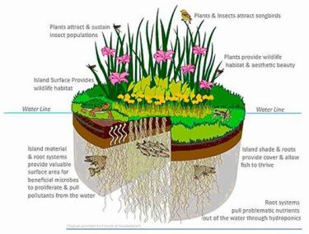
Phosphorus Removal
Performance at Deal Lake and Dukes Farm, NJ
One 250 ft² FWI can remove about 10 lbs of TP per year.
1 lbs of TP has the potential to generate up to 1,100 lbs of algal biomass.
Thus, one 250 ft² FWI can reduce algal biomass by about 11,000 lbs per year.

Slide 8
Floating Wetland Islands
FWIs use a synthetic base material as a planting bed
Native vegetation is planted through the base
Plant roots extend through base material
Plants extract nutrients from water… “hydroponic garden”
The large surface area of base material provides habitat for microbial communities that also assimilate available nutrients, some of which is transferred to the plants

Slide 9
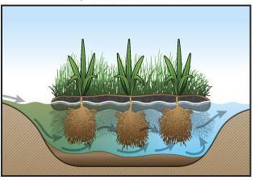
Floating Wetland Islands
Courtesy of Floating Island International

Slide 10
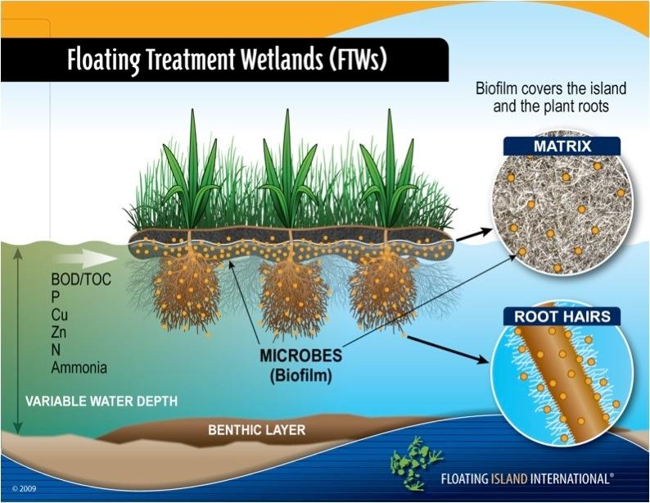

Slide 11
Base Material…. “Island”
Three primary manufactures -
Floating Island International – Biohaven Islands - floatingislandinternational.com
Beemats, LLC - Managed Aquatic Plant System Floating Wetlands - beemats.com
Maryland Aquatic Nurseries (MAN) - Modular Floating Wetlands - marylandaquatic.com

Slide 12
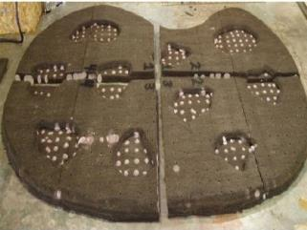
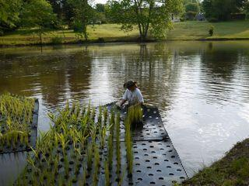
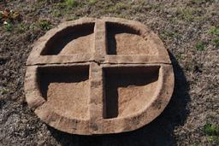
Floating Island International
Beemats
Maryland Aquatic Nursery

Slide 13
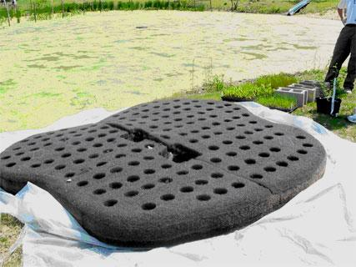
Base - Matrix, Foam and PVC
Matrix - Nonwoven fibers from recycled PET plastic drinking bottles
Foam - Coast Guard approved inert polyurethane, provides adhesion and buoyancy. PVC Pipe – Forms frame, is inserted between two layers of matrix and cable used to connect islands to one another
Adapted from Bluewing Environmental Solutions and Technologies and Floating Island International

Slide 14
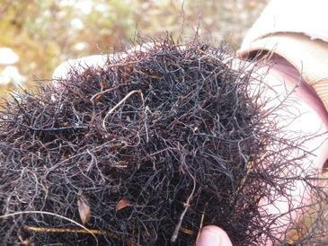
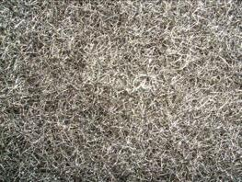
Mimics Wetland Surface Areas
Synthetic Base
Floating Island International
Natural Base

Slide 15
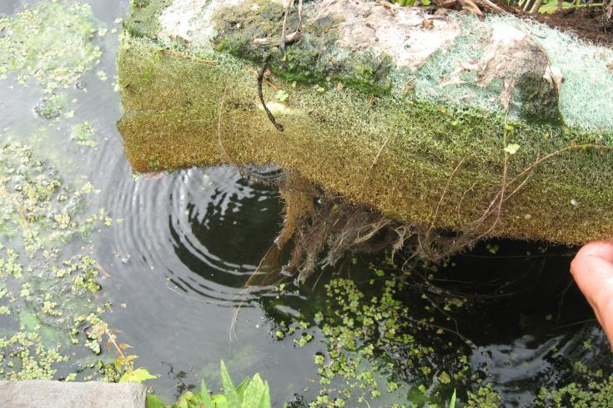
Matrix After One Month of Growth

Slide 16
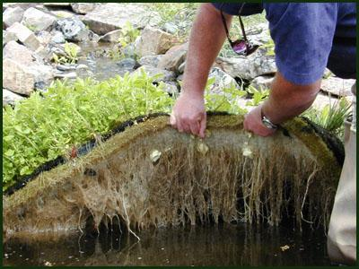
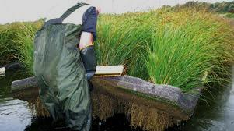
Biohaven FWI
Rapid Root Penetration

Slide 17
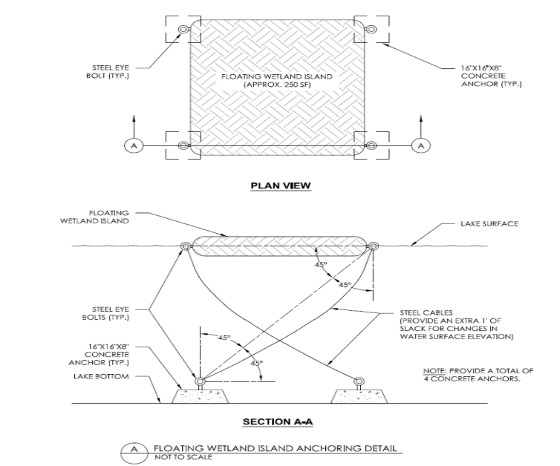
Must be firmly anchored

Slide 18
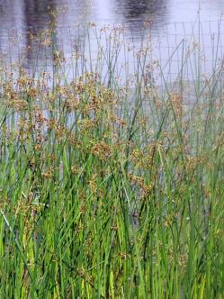
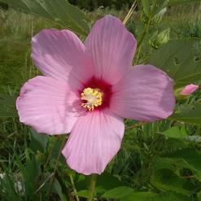
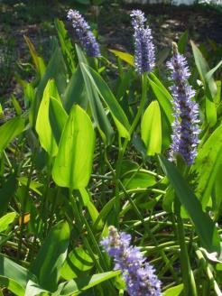
Suitable Plant Species
Swamp milkweed
New England aster
Rice cutgrass
Swamp-rose mallow
Fringed sedge
Soft rush
Pickerelweed
Blue-flag iris
New York ironweed
Soft stem bulrush

Slide 19
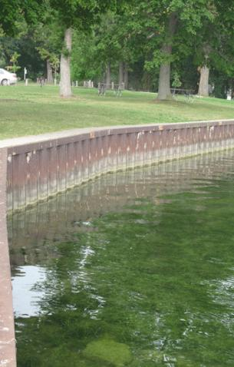
Recreating Littoral Habitat
Can help mitigate for some of the habitat losses experienced in ponds dominated by “hardened shorelines”
Anchored adjacent to bulkheaded or sheet-pile lined shorelines islands create substitute habitat
May also lessen the “echo” effect and transfer of wave energy bouncing of hardened shoreline

Slide 20
Correct Edge Erosion Problems

Slide 21
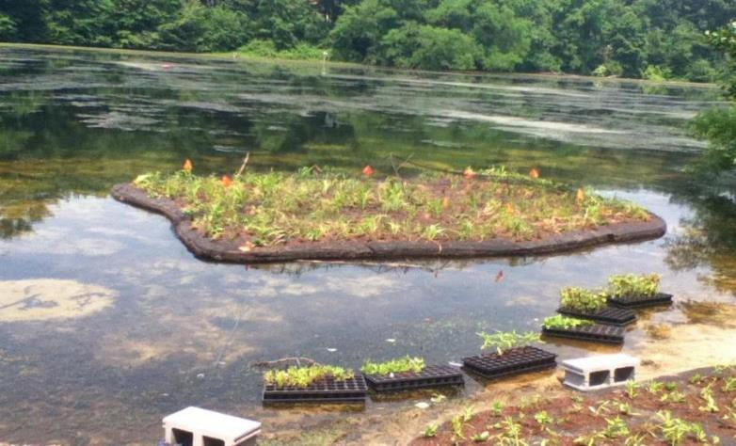
Create Sub-Surface Fish Habitat

Slide 22
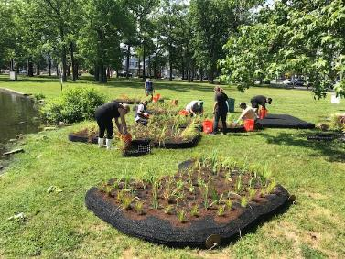
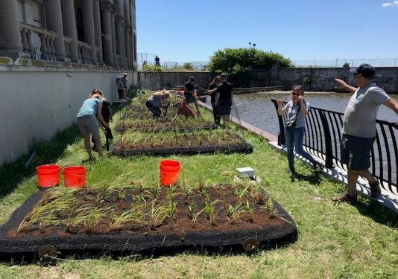
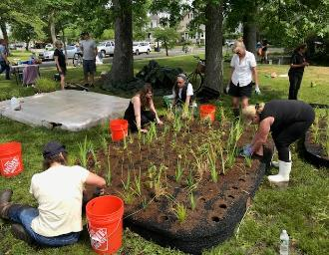
Community Involvement – Deal Lake, Wesley Lake and Sunset Lake volunteers
Photos – Deal Lake Commission

Slide 23
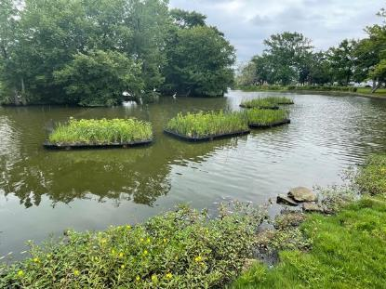
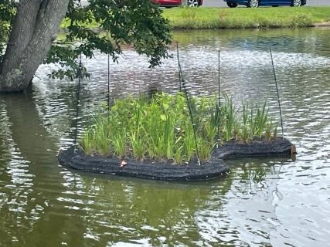
FWI Installation at Sunset Lake (2021)
Note Goose Fencing Along Perimeter of the Island

Slide 24
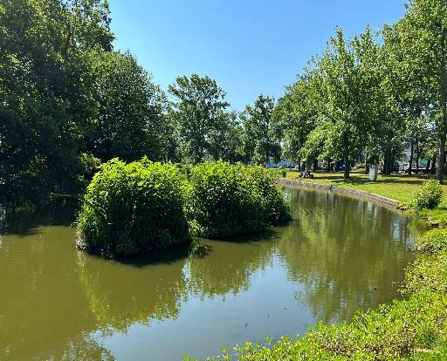
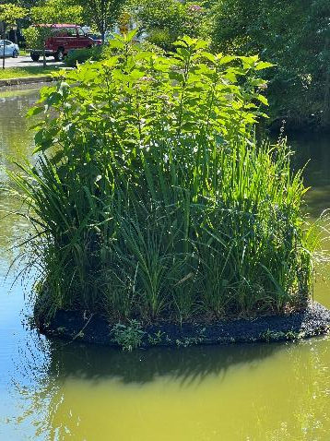
FWI at Sunset Lake (2022)
One Year Post-Installation

Slide 25
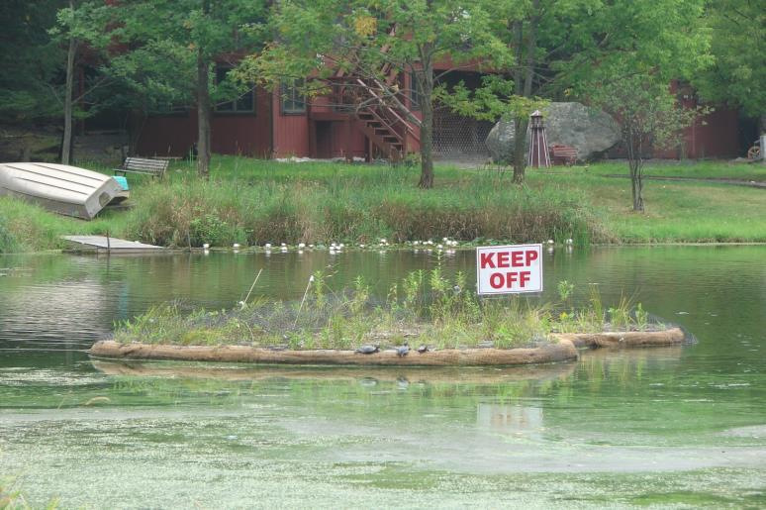
Protect Your Investment
Note Goose Fencing Along Perimeter of the Island
Photo Courtesy of Princeton Hydro

Slide 26
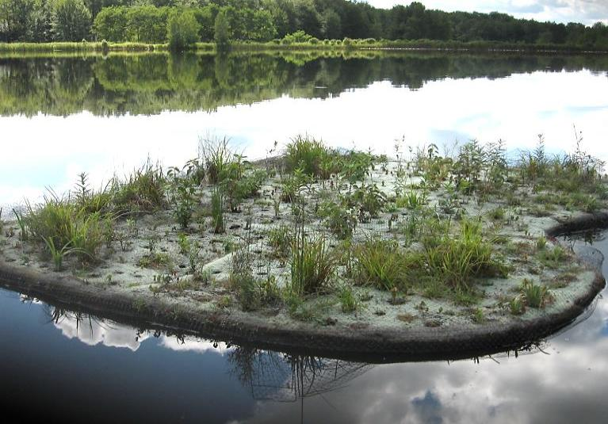
1-Year Post Installation – Why Poor Success?
Photo Courtesy of Princeton Hydro

Slide 27
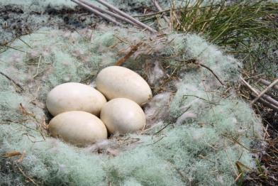
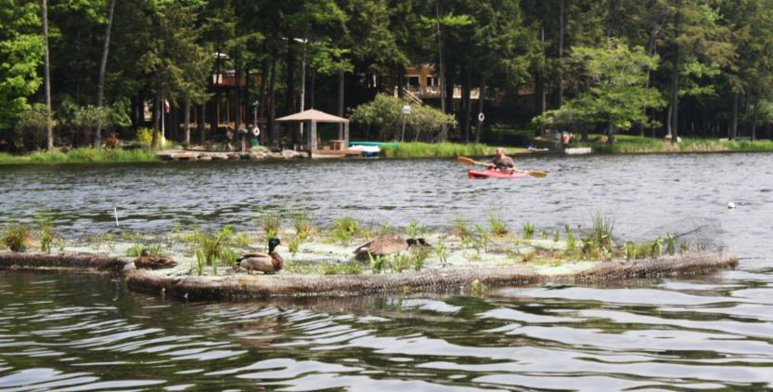
This Is Why!!
No Goose Fencing Along Perimeter of the Island
Photos Courtesy of Princeton Hydro

Slide 28
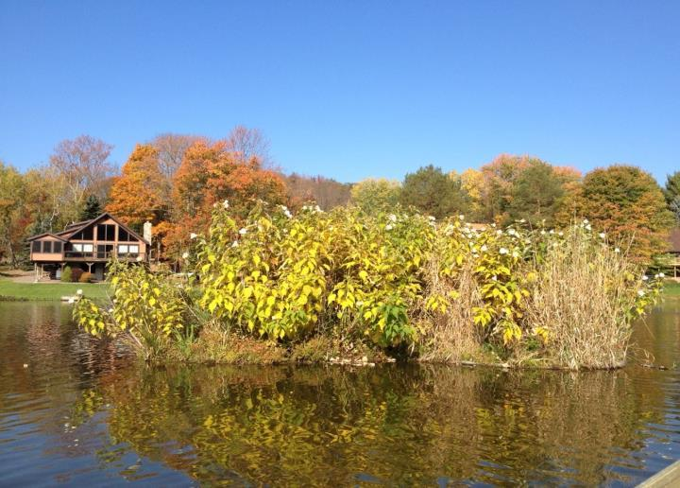
Time to Harvest and Start Over
Photo Courtesy of Princeton Hydro

Slide 29
Limitations of FWIs
Cost/Pound TP removal high, $800/lb.
Total removal a function length of growing season, flow and contact time
Certain plants function better than others
Waterfowl / wildlife control measures required
Harvesting/replanting costs
Most cost effective at TP conc > 0.10 mg/L

Slide 30
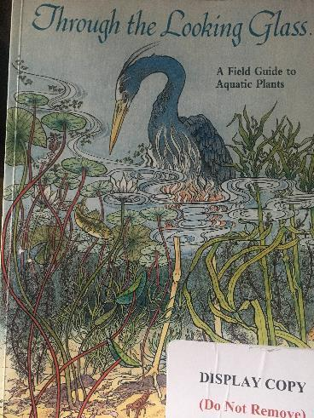
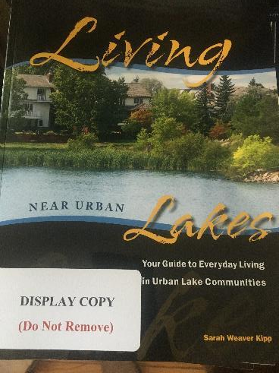
Plants for Nearshore Area

Slide 31
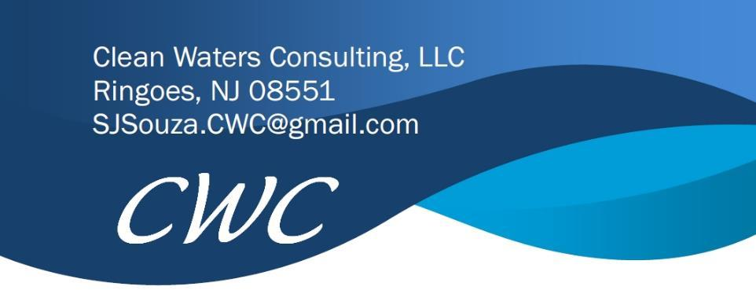
Thank You
Stephen J. Souza, Ph.D.

