Slide 1

Manufactured Treatment Devices;
A Stormwater Management
Option for Urban Sites
Stephen J. Souza, Ph.D.

Slide 2
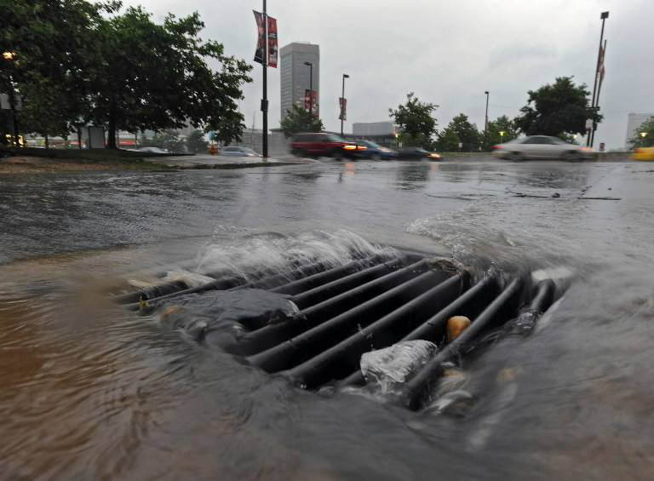
Challenges Of Retrofitting Urban and Suburban Stormwater Systems
Lack of space for surface GI BMPs
Flashy flows
Inconsistent flows
Sediment, litter and trash
Specialized maintenance needs

Slide 3
Manufactured Treatment Devices
Green/gray SW solutions
Sub-surface; decreases land availability requirements
Scalable
Often no need to make major changes to existing SW infrastructure
NJDEP accepted SW solution
Peak flow mitigation but limited recharge
Remove mostly particulate pollutants and TSS (50-80%) not much dissolved nutrient / pollutant removal

Slide 4
MTD Utilization for New Development as per NJDEP
An MTD must be NJCAT verified and NJDEP certified if used to satisfy requirements for major development as per NJAC 7:8 (Stormwater Rules).
For projects receiving New Jersey Environmental Infrastructure Financing Program (NJEIFP) funding, an MTD must be either: 1) NJCAT verified and NJDEP certified or 2) installed as per the NJEIFP MTD Funding Policy.
An MTD not NJCAT verified or NJDEP certified may be used only if the MTD is not intended to satisfy the requirements of NJAC 7:8 and is not subject to NJEIFP MTD Funding Policy.
For list of qualifying MTDs and more details go to: https://nj.gov/dep/stormwater/treatment.html

Slide 5
NJDEP’s Take on MTDs As
Green Infrastructure Option
For an MTD to be considered by NJDEP as “green infrastructure”, the MTD must meet the NJAC 7:8-1.2 green infrastructure definition.
Specifically, the MTD shall (1) infiltrate into the subsoil; and/or (2) treat stormwater runoff through filtration by vegetation or soil.

Slide 6
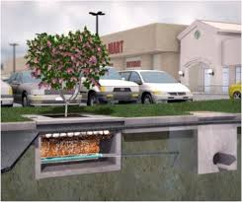
Use of MTDs in
Barnegat Bay Watershed
Much of BB watershed developed before GI requirements and even basic stormwater management requirements of NJAC 7:8
Option for retrofit and redevelopment
Pre-treatment for GI SWM techniques
Illustration from:
Journal of Env. Engineering
Vol 144:2, 2018

Slide 7
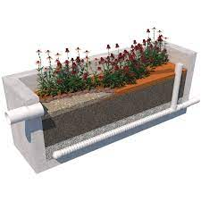
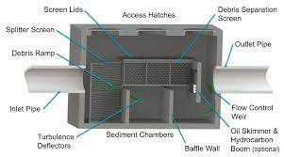
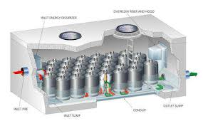
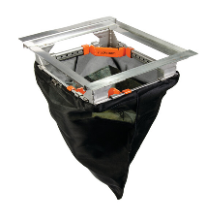
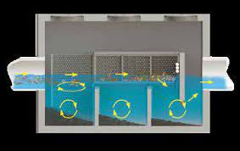
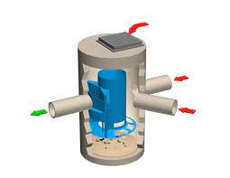
Variety of Designs and Applications

Slide 8
Variety of Designs and Applications
Basin inserts and filter bags
Tree and planter boxes
Large chamber baffle boxes
Large chamber swirl condensers and hydrodynamic separators
Media filtration and cartridge filtration systems
Visit: https://nj.gov/dep/stormwater/treatment.html

Slide 9
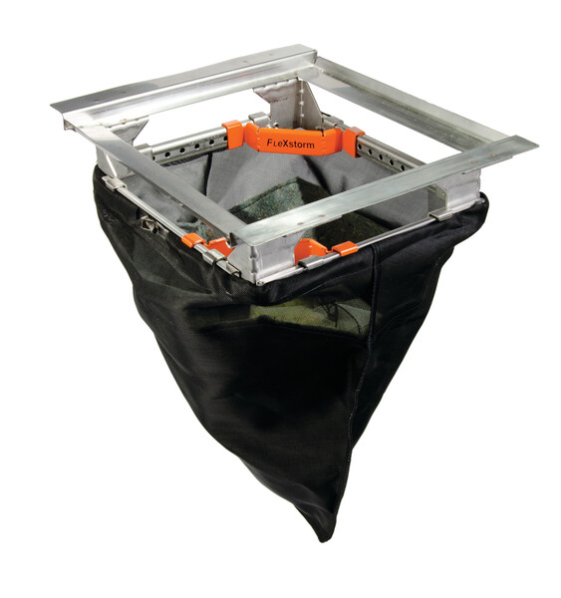
Flex Storm™
Catch Basin Inserts
Filter removes sediment, leaf litter, and other particulates
Treats runoff generated by 1-yr event and 1st flush of larger storms

Slide 10
Catch Basin Inserts
Stainless steel frame adaptable to various size catch basins…
As per FlexStorm
Capable of 99% TSS removal @ flow rate of 137 GPM/Ft²
Filter bag capacity
5-6 Ft³

Slide 11
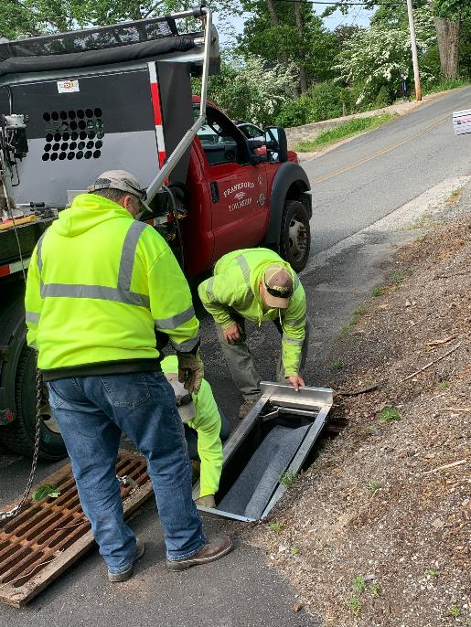
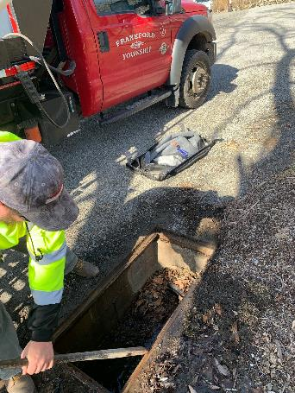
Catch Basin Modification

Slide 12
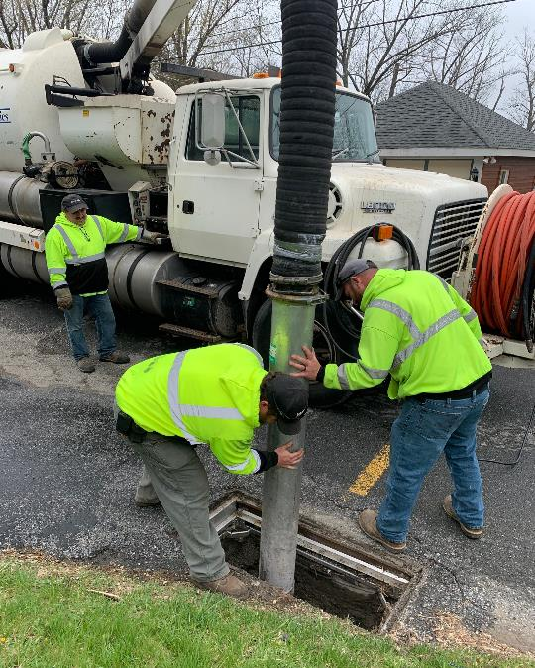
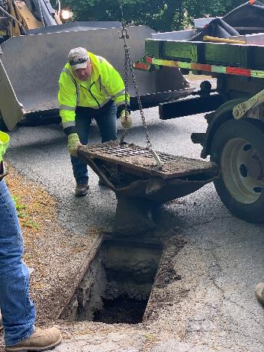
Catch Basin Clean Out

Slide 13
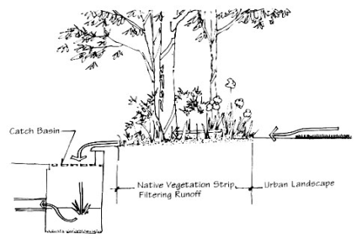
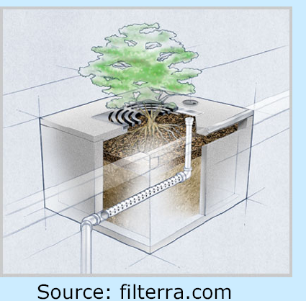
Tree and Planter Boxes / Tree Trench
Filtration, assimilation of dissolved pollutants
and potentially some recharge

Slide 14
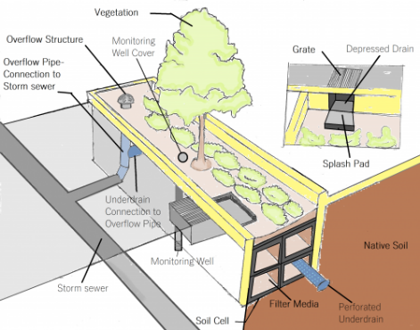
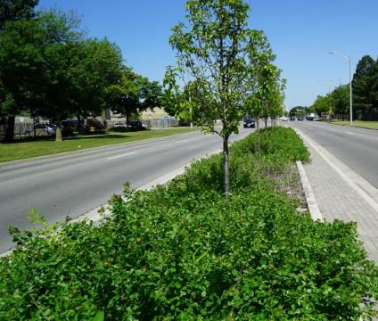
Tree Trench
https://wiki.sustainabletechnologies.ca/wiki/Stormwater_Tree_Trenches

Slide 15
Planter Boxes
Custom concrete boxes of variable size
Treats only small volume of runoff (1-year storm and 1st flush of larger storms)
Runoff diverted into boxes via pipe, weir or simple curb-cuts
Best when built with under-drain to prevent prolonged standing water
Fill with a bioretention soil mix
Plant with typical bioretention vegetation

Slide 16
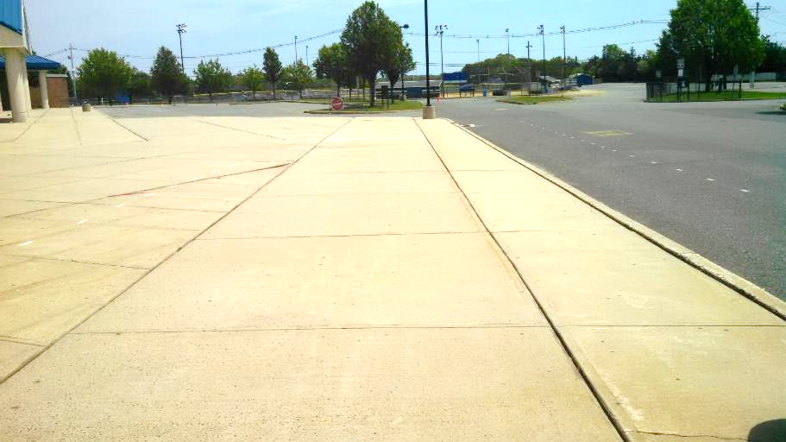
Example – Toms River HS North

Slide 17
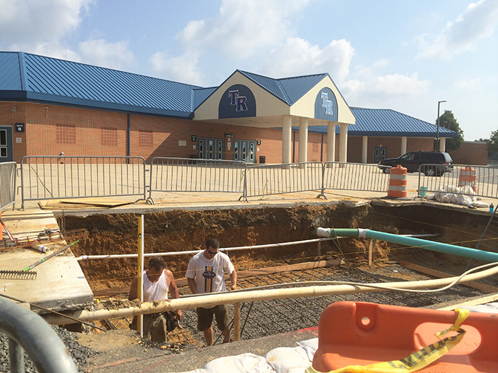

Slide 18
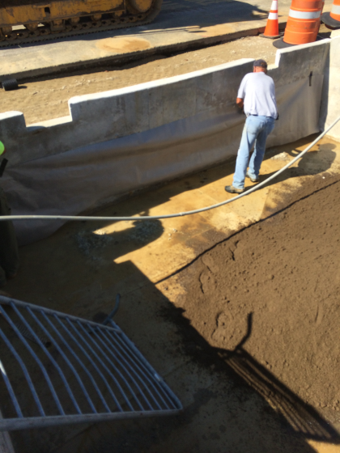
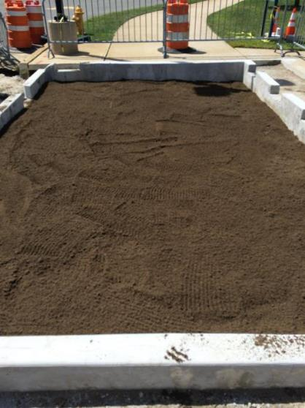

Slide 19
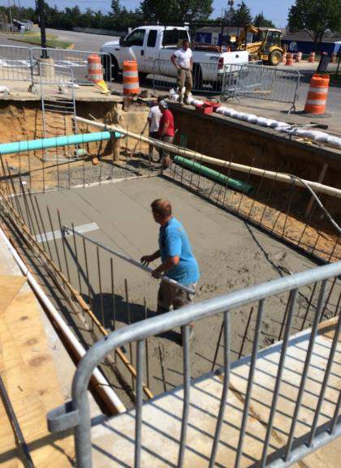
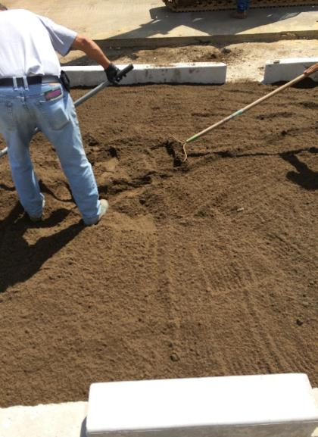

Slide 20
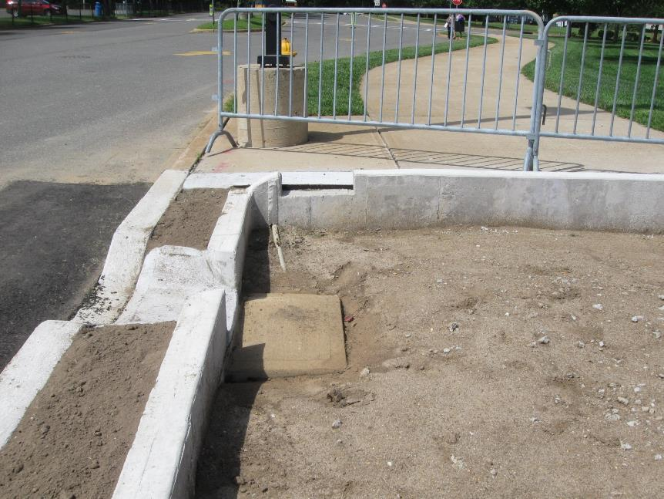

Slide 21
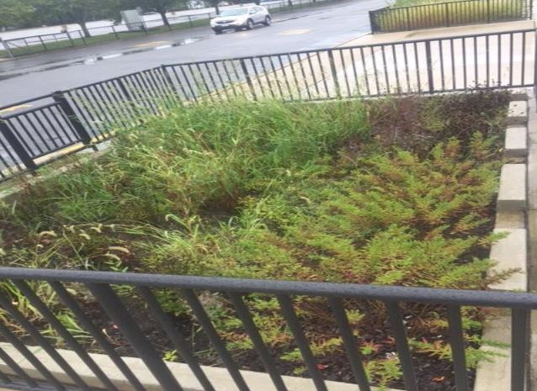

Slide 22
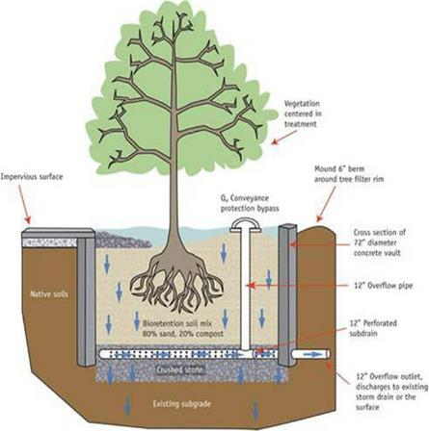
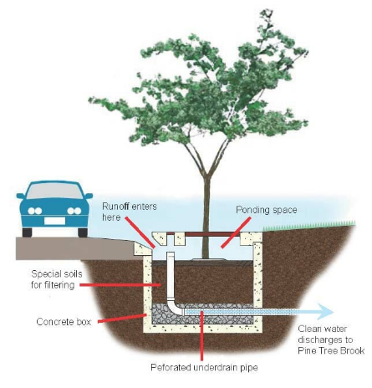
Tree Boxes
Source: University of New Hampshire, Stormwater Center. 2009 Biannual Report
Source: https://www.townofmilton.org/stormwater-management/pages/tree-filter-boxes-milton

Slide 23
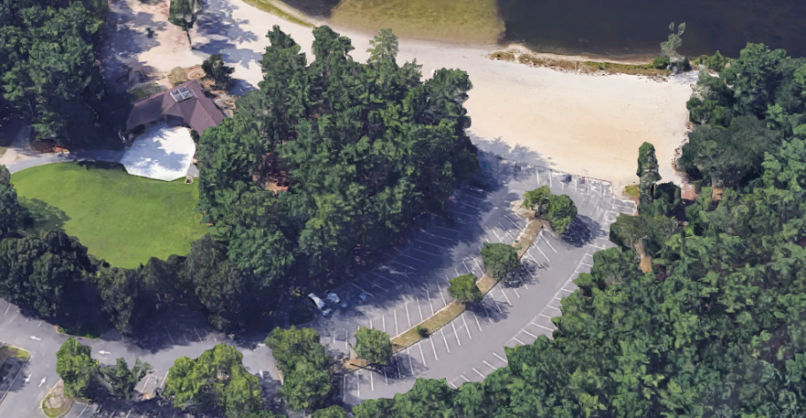
Tree Box Installation OCP, Lakewood
Discharge
Tree Box 1
Tree Box 2
Filterra™ Tree Boxes passively biotreat parking lot runoff that flowed unabated into Swimming Lake

Slide 24
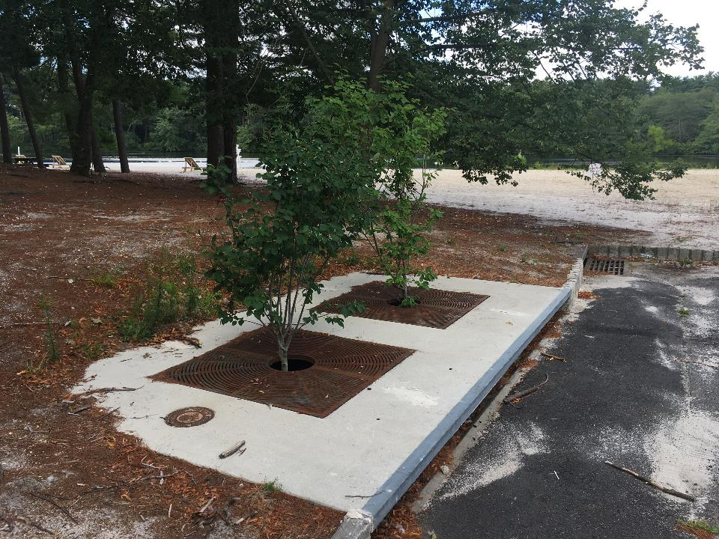
Filterra™ Tree Boxes OCP

Slide 25
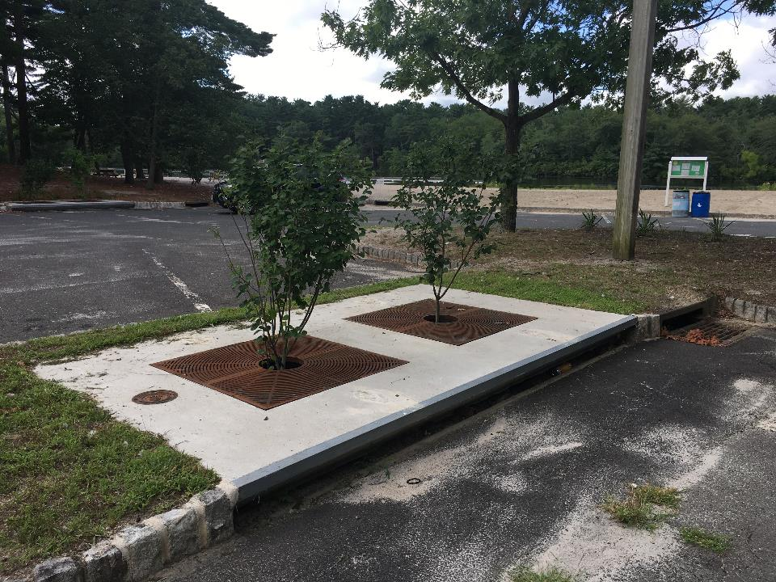
Filterra ™ Tree Boxes OCP

Slide 26
Toms River HS North
Filterra ™ Tree Boxes
Filterra tree box (91 ft²) installed in high school southwestern parking lot
Modify curb line to direct low flow into box
Planted with two 6-7 feet tall Serviceberry (Amelanchier canadensis)
Treated flow leaving Filterra unit discharged into a large sub-surface MTD for added flow management and TSS removal

Slide 27
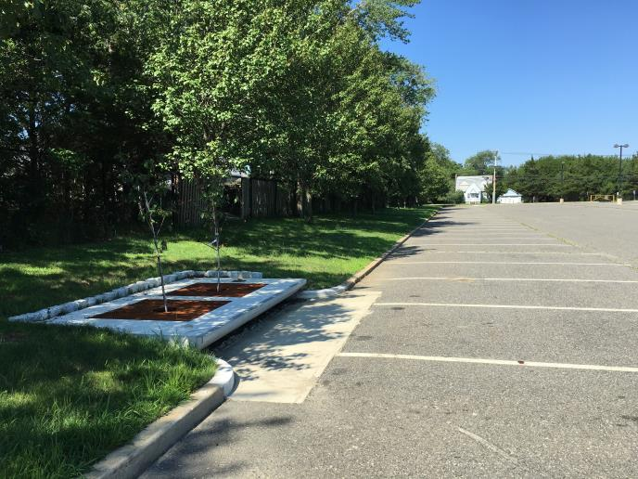
Retrofit of Existing Parking Lot Drainage System Toms River HS North

Slide 28
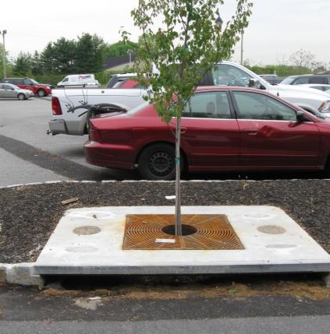
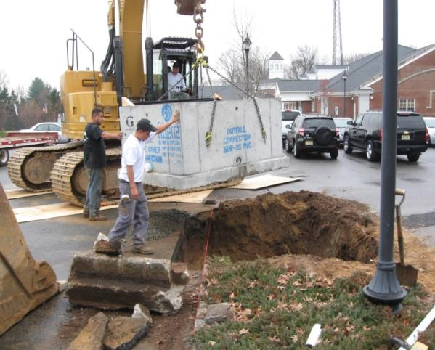
Tree Box Retrofit of Existing Parking

Slide 29
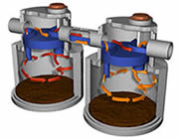
Large MTDs
https://www.conteches.com/stormwater-management/treatment/vortechs

Slide 30
Large MTD –
Toms River HS North
Vortechs 16000 MTD treats runoff exiting the Filterra unit plus additional parking lot runoff
The Vortechs 16000 is a hydrodynamic separator, combines swirl concentration and flow controls to trap and remove trash, debris, sediment, and hydrocarbons from runoff
The MTD discharges to existing stormwater system

Slide 31
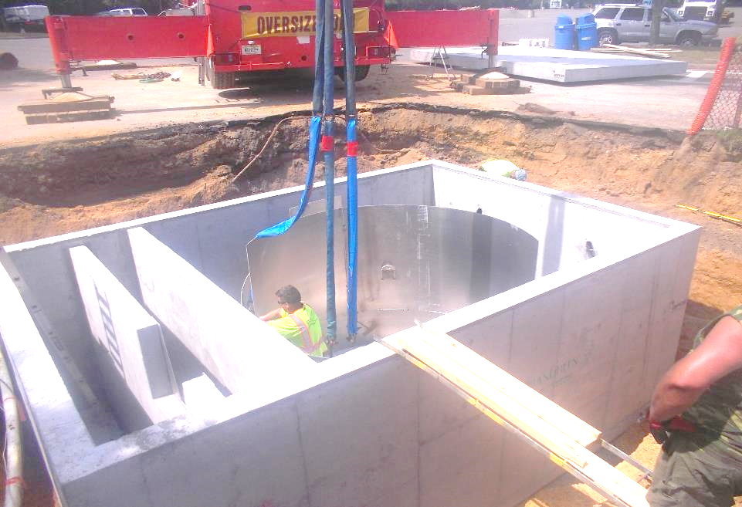
Basin Baffles
Helical Swirl Condenser
Flow path
MTD Installed at Toms River HS North

Slide 32
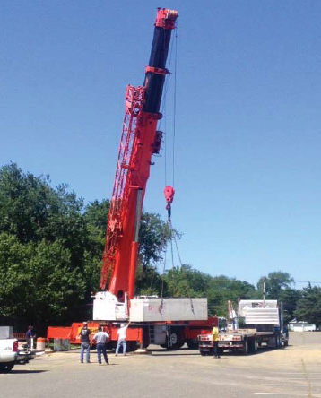
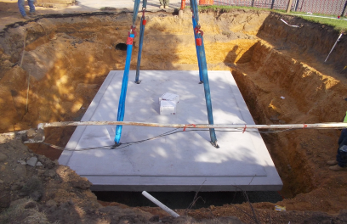
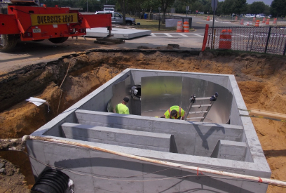
MTD Installed at Toms River HS North

Slide 33
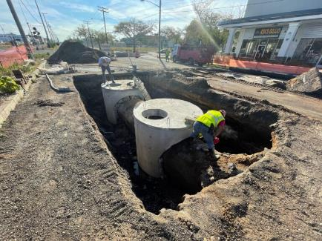
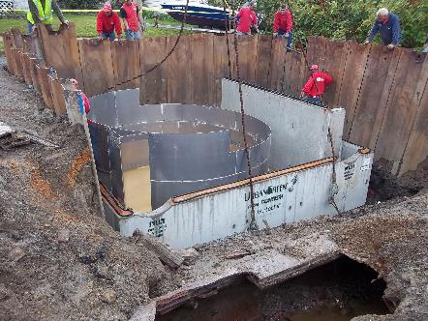
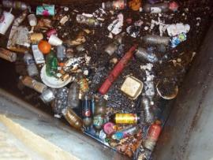
Large MTD Installations
Deal Lake, Asbury Park
Due to limited open space use both large and small subsurface MTDs to treat stormwater runoff…effective means of controlling floatables, sediment, particulate pollutants and nutrients…inspected quarterly and cleaned out

Slide 34
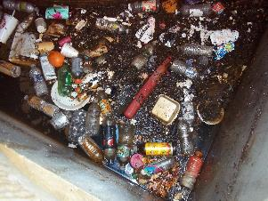
Deal Lake –
Comstock Ave, Asbury Park HS
Six-months of accumulated debris

Slide 35
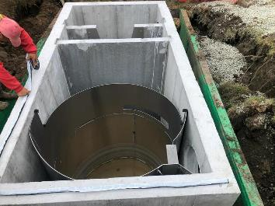
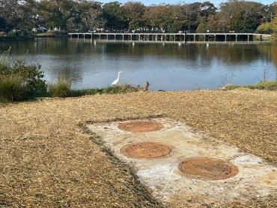
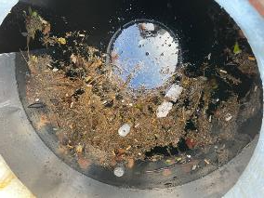
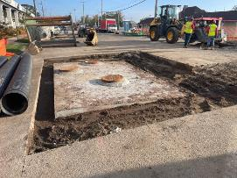
Other Deal Lake Installations
Debris and oil trapped after one storm

Slide 36
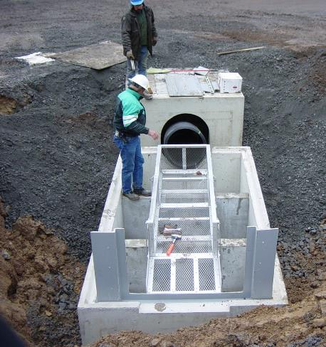
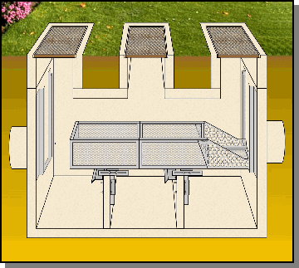
Suntree ™ MTD
Achieved 8 tons of sediment removal w/in 4 months

Slide 37
Summary
Although all MTDs are not “true” GI SWM solutions, they do treat runoff better than conventional gray SW techniques
Especially suitable for retrofit applications
Limited amount of land requirements
Installed without major alterations of existing infrastructure
Good for particulate pollutant and sediment removal

Slide 38
Summary
Require frequent inspection and maintenance
Maintenance may require specialized equipment and trained personnel
Can only manage limited catchment area…OK for small volume of runoff
But, can be linked with GI SWM techniques or used as pre-treatment to increase pollutant removal

Slide 39

Thank You…Questions
Stephen J. Souza, Ph.D.

