Slide 1

Converting and Retrofitting Conventional Detention Basins

Slide 2
The Need to Tame
Stormwater Runoff

Slide 3
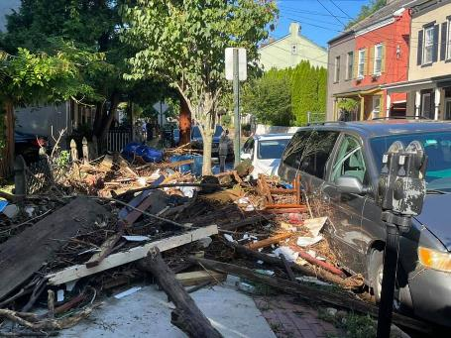
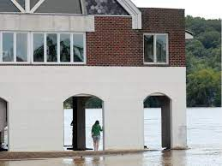
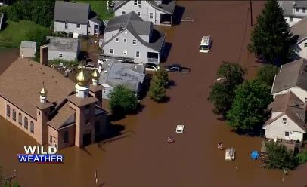
Extreme Rainfall Events
Headline…Death Toll Tops 40 After Ida's Remnant Blindsides Northeast
Assoc Press…Sept 3 2021

Slide 4
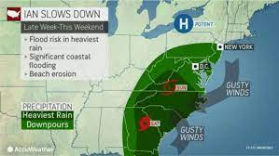
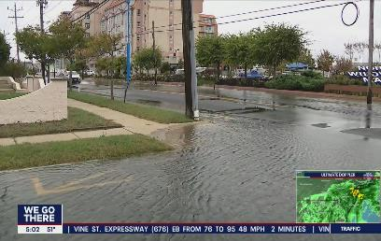
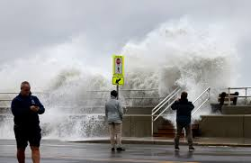
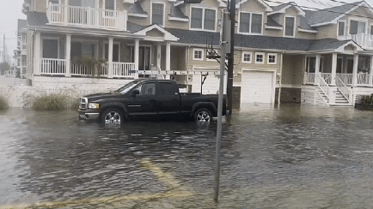
Hurricane Ian
2 Oct 2022 – NJ coastal flooding and beach erosion due to Ian

Slide 5
Water, Water Everywhere
National Oceanic and Atmospheric Administration calculated the total damages from floods and hurricanes during 2021 eclipsed $100 billion!
NOAA estimates sea level will rise by 10”-12” by 2050.
This, along with the increasing occurrence and frequency of storm events, puts many of the most populated areas of the nation at increased risk of repeated flood induced damage.
NOAA – February 2022- Sea Level Rise Technical Report
https://oceanservice.noaa.gov/hazards/sealevelrise/sealevelrise-tech-report-sections.html

Slide 6
But Its Not Just The Extreme Events
Proper planning needed to deal with extreme events…but
Smaller, more frequent events need to be given greater emphasis and priority.
Greater return frequency storms (0.5-yr, 1-yr and 2-yr events) result in…
  Increased frequency of localized nuisance flooding.
  Exacerbated environmental stress.
  Chronic, repeating ecological impacts.

Slide 7
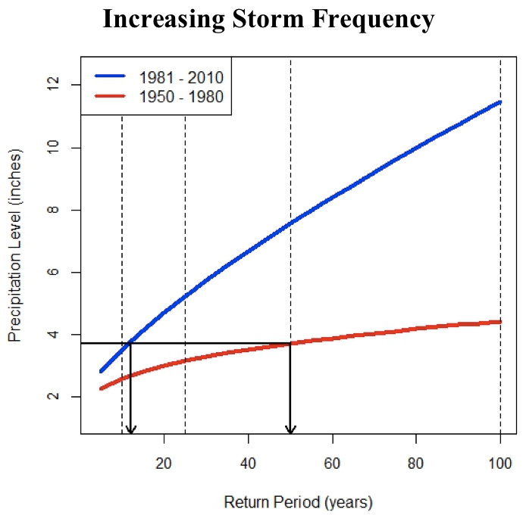
These events account for 90% of all the rainfall typically recorded annually
https://extension.umaine.edu/maineclimatenews/home/adapting-to-extreme-rainfall/

Slide 8
Stormwater Related Impacts
Scour and erosion of waterways
Increased sediment loading
Increased nutrient loading
Increased influx of contaminants
Dam failures / Property damage
Accelerated eutrophication
Loss of ecological services and functions

Slide 9
Small Storm Management Approach
Can’t manage all of the runoff from 100-yr storm
But can lessen the impacts of more common storms that cause “nuisance flooding” and chronic environmental impact
Green infrastructure does this especially well…why?
  Less volume
  More pollutant removal
  Lower peak flow
  More recharge

Slide 10
Control Smaller Frequent Events
1yr-24 hr storm = 2.75”
2yr -24 hr storm = 3.3”
    (https://www.nrcs.usda.gov)
Capture and retain entire runoff volume of 1 and 2 year events
Eliminates runoff generated by 93-95% of all storms occurring annually
1 yr event over a 15% impervious 1-acre lot generates ~10,000 gallons of runoff

Slide 11
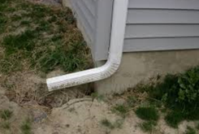
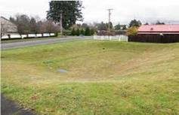
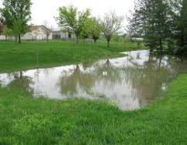
Standard Detention Approach
Quickly concentrate runoff.
Route runoff to centralized detention basin.
Store runoff for a fixed time and release at controlled rate.
Results:
  Peak flow decreased…but
  Minimal volume reduction.
  Little recharge.
  Low amt of pollutant removal.

Slide 12
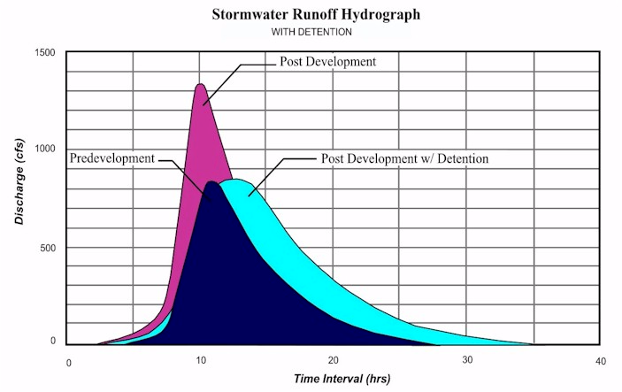
Detention does reduce peak flow…but not much more
Source: Pennsylvania Stormwater Management Manual

Slide 13
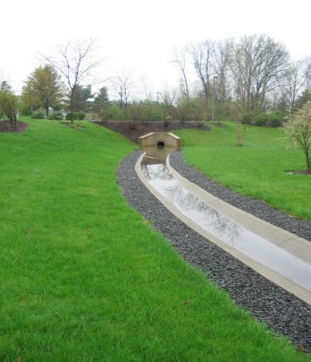
Detention Can’t Solve
All Runoff Problems
For Barnegat Bay we also need to…
Reduce off site runoff volume.
Maximize recharge of precipitation.
Remove or reduce pollutants… including nitrogen and phosphorus.

Slide 14
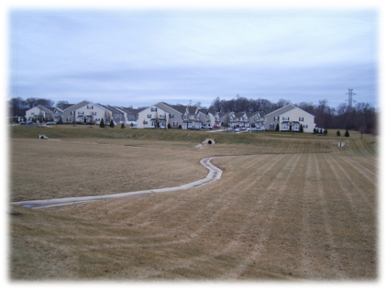
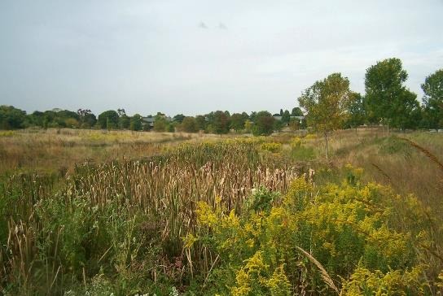
Detention Basins Retrofit
Large amount of development in Barnegat Bay relies on basic detention basins to manage runoff.
Each existing detention basin is an opportunity for better SW management.
Need to be converted into bioretention or bio-infiltration basins
So how do we get from this...
to this

Slide 15
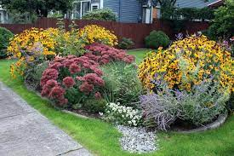
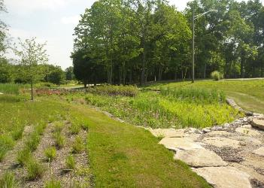
The Bioretention Approach
Use soils and plants to passively treat runoff.
Keep runoff on site for as long as possible; retain, assimilate and recharge!
Focus on smaller storm events (0.5, 1, and 2-year storms).
But scalable…works for small and large catchment areas.

Slide 16
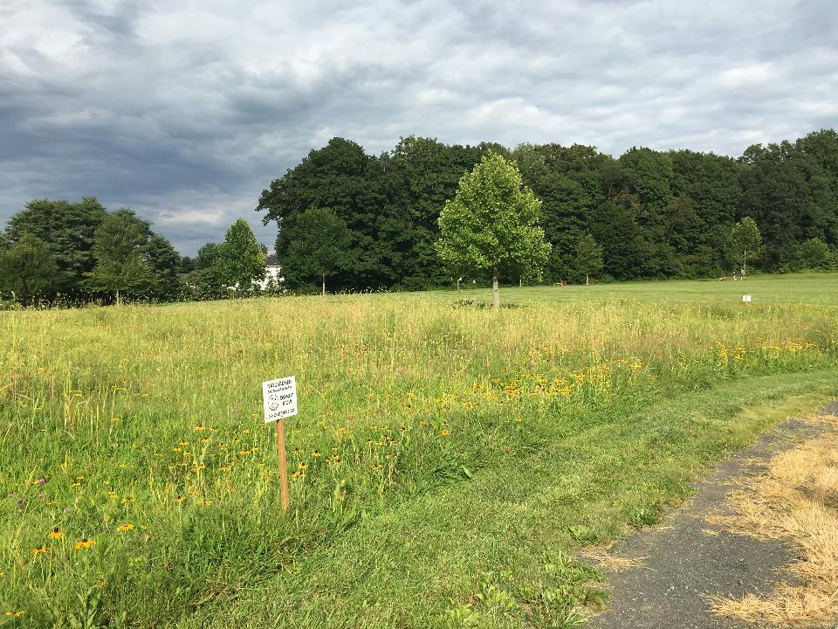
Beyond Detention
Naturalization – Minimal modification of the existing basin, no reconditioning of basin soils and no re-planting…basin allowed to “go fallow”.
Retrofit – Involves an extensive modification of the existing basin including reconditioning of the soils and re-planting of basin with specific types of plants.

Slide 17
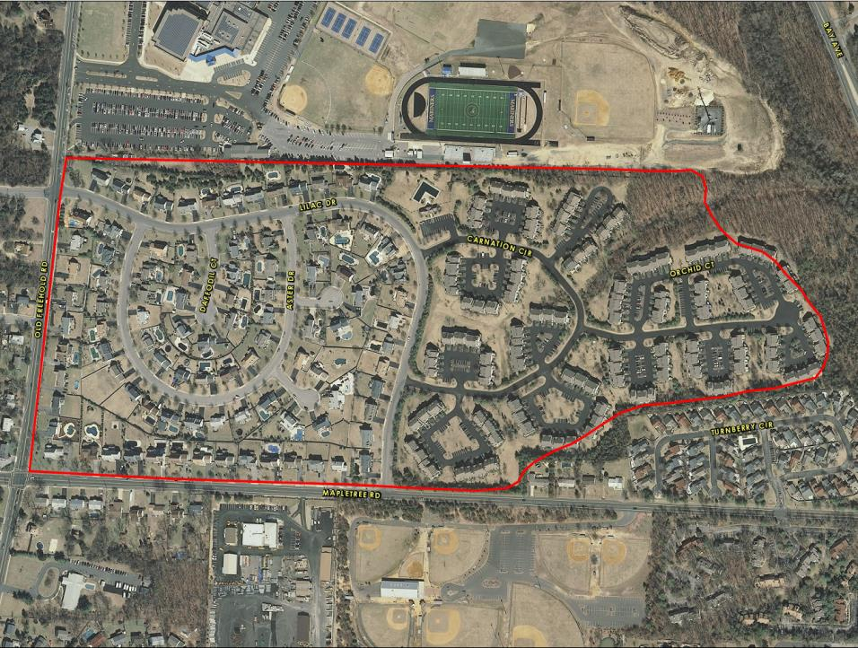
Laurel Commons, Toms River
Carnation Circle Basin Retrofit
Outflow
Inflow 1
Inflow 2
Total Drainage Area 76.8 acres

Slide 18
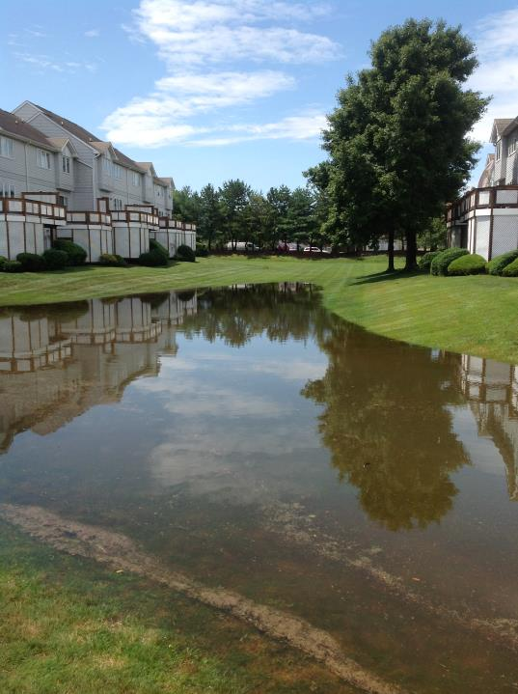
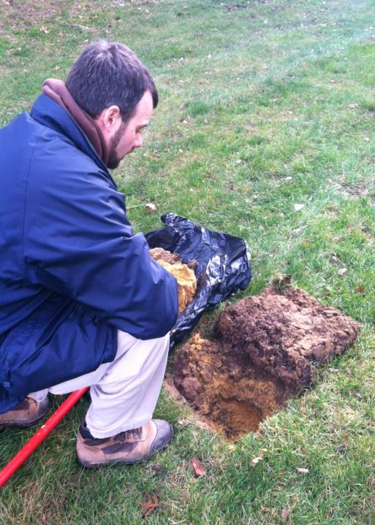
Converted Detention Basin

Slide 19
Carnation Circle Basin Improvements
Convert detention basin into bioretention basin.
Increase nitrogen removal and infiltration, reduce overall maintenance, decrease off-site stormwater volume discharge.
Keep things simple…work with existing infrastructure.
Proximity to adjacent houses required advanced meetings with public to address issues such as flooding, mosquitos, aesthetics, etc.

Slide 20
Carnation Circle Basin Improvements
Basic approach –
  “Skim off” compacted soil / expose native soils.
  Amend sandy sub-soils with organic compost.
  Slow and detain flow using gravel check dams/weirs.
  Plant with deep rooted meadow grasses having low maintenance requirements and compliment with flowering plants.
  Establish renovated basin as a no-mow area
The project’s total area of disturbance > 30,000 square feet.

Slide 21
Carnation Circle Basin Improvements
Soil amendments included the placement of two (2) to three (3) inches of leaf compost spread evenly over the soil amendment area.
Compost exclusively matured, decomposed deciduous leaves with less than 5% dry weight of woody or green yard debris materials.
Compost tilled into basin bottom to minimum depth of 12 inches.
Renovated bottom rototilled to a minimum depth of six (6) inches.

Slide 22
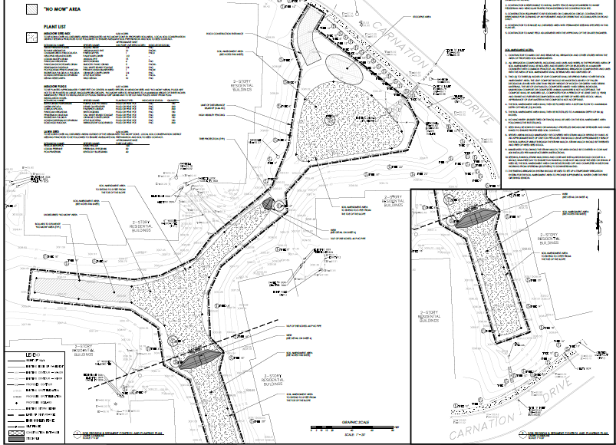
Meadow grasses
Outlet control structure
Gravel check dam
Meadow grasses
Gravel check dam
Meadow grasses

Slide 23
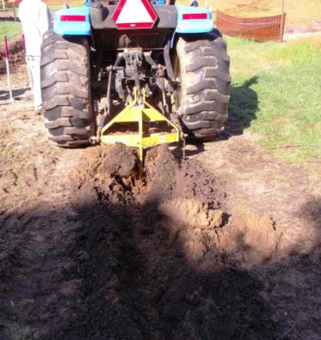
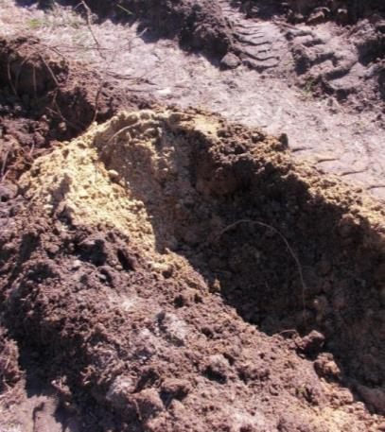
Site Preparation

Slide 24
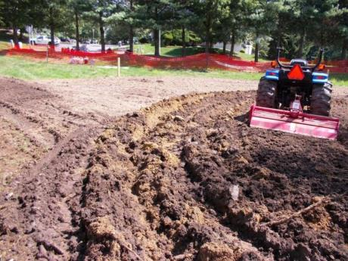
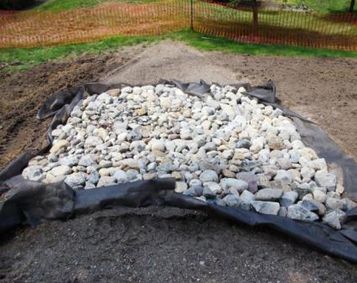
Site Preparation

Slide 25
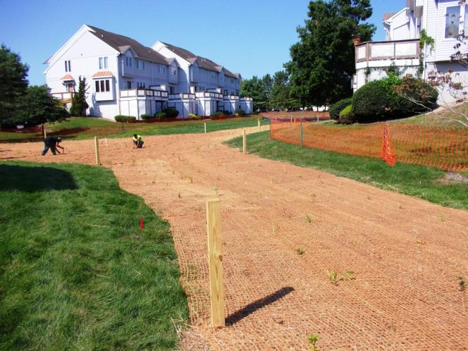

Post-Construction – Pre-Planting

Slide 26
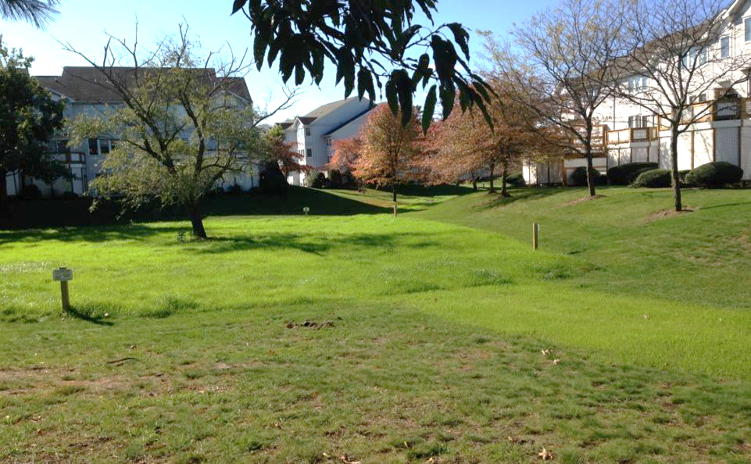
2013 - Month 2 After Conversion

Slide 27
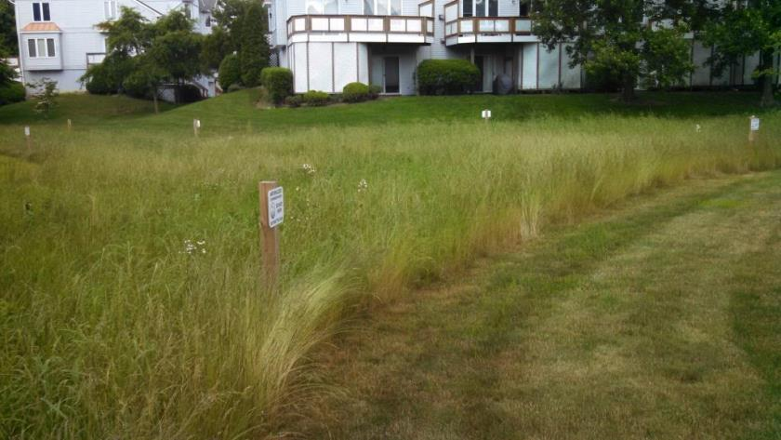
End of First Growing Season

Slide 28
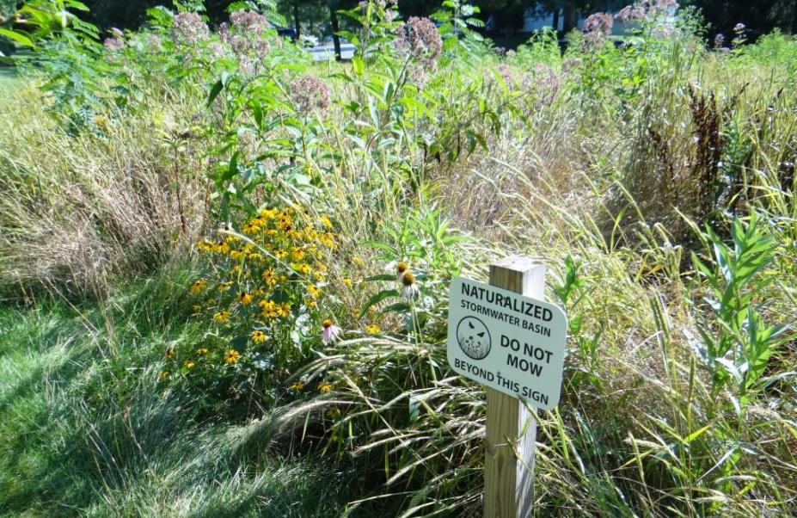
Summer 2014 - 1 Year After Conversion

Slide 29
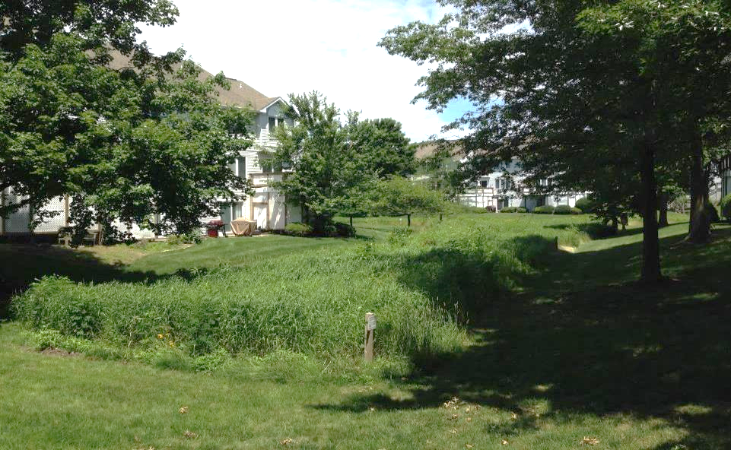
Spring 2015 – 2 Years of Grow-In Time

Slide 30
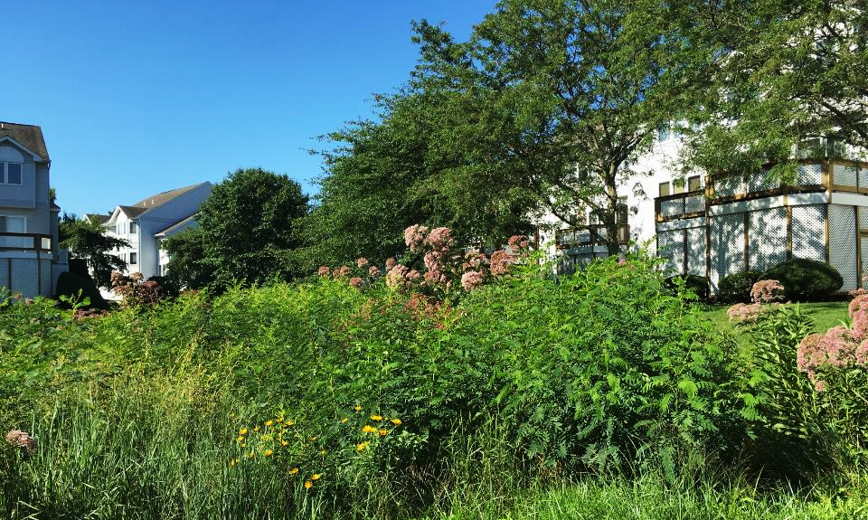
August 2016

Slide 31
August 2016

Slide 32
MEADOW SEED MIX: SOWN IN ALL AREAS DESIGNATED AS MEADOW CREATION 24,250 ft²
BOTANICAL NAME: | SPECIES NAME: | APPROXIMATE RATE (LBS PURE LIVE SEED/ACRE) | INDICATOR STATUS:
ECHINACEA PURPUREA | PURPLE CONEFLOWER | 1/2 | -
ERAGROSTIS SPECTABILIS | PURPLE LOVEGRASS | 4 | FACU
LOLIUM MULTIFLORUM | ANNUAL RYE | 15 | -
PERSICARIA PENSYLVANICA | PENNSYLVANIA SMARTWEED | 2 | FACW
RUDBECKIA HIRTA | BLACK EYED SUSAN | 1/4 | FACU
SCHIZACHYRIUM SCOPARIUM | LITTLE BLUE STEM | 6 | FACU
TRIDENS FLACUS | PURPLETOP | 2 | UPL
SYMPHYOTRICHUM LATERIFLORUM | CALICO ASTER | 1/8 | FAC
SOLIDAGO JUNECA | EARLY GOLDENROD | 1/4 | -
CHAMAECRISTA FASCICULATA | PARTRIDGE PEA | 1 | FACU
LAWN RESTORATION SEED MIX: TO BE SOWN IN ALL AREAS OF DISTURBANCE EXCLUDING DESIGNATED MEADOW PLANTING AREA
BOTANICAL NAME: | SPECIES NAME: | APPROXIMATE RATE (LBS PURE LIVE SEED/ACRE) | INDICATOR STATUS:
FESTUCA BREVIPILA | HARD FESCUE | 120 | UPL
LOLIUM PERENNE | PERENNIAL RYEGRASS | 30 | FACU
POA PRATENSIS | KENTUCKY BLUEGRASS | 40 | FACU

Slide 33
Summary
Basin retrofit / naturalization makes sense for Barnegat Bay
Plenty of opportunities
Relatively inexpensive
Soils amenable for bioretention and bio-infiltration
Reduces runoff volume, increases rechange, decreases pollutant loading, decreases stream erosion

Slide 34
Summary
Climate change causing increase in frequency of extreme storm events
Although can’t always fully mitigate impacts of extreme storms can improve resiliency and lessen impacts of “nuisance flooding”
Can be accomplished with green infrastructure
Focus on retaining and recharging runoff onsite

Slide 35
In Summary…
Naturalized and renovated detention basins, capable of controlling peak flow.
But more importantly, far more effective at reducing the volume of runoff, increasing recharge and decreasing pollutant loading.
A function of plants and soil media work in concert to yield the desired results.

Slide 36
In Summary…
Success of basin naturalization/retrofit a function of “homework”… must know the hydrology, hydraulics and environmental features of site and the targeted basin.
Be careful w/ plant selection...converted basins are often drier than expected.
Don’t compact soil during renovation.
Make sure design facilitates easy access and routine maintenance.

Slide 37

Thank You…Questions
Stephen J. Souza, Ph.D.

