Slide 1
Inspection of Stormwater Management Facilities (Detention/Retention/Infiltration Basins and Catch Basins) Save Barnegat Bay NEMO Program
Rutgers Cooperative Extension Water Resources Program
Chris Obropta

Slide 2
Overview
Tier A Permit Requirements
Catch Basin Inspections
What are Detention/Retention/Infiltration basins?
Typical Basin Structure
Detention/Retention/Infiltration Basin Inspection
Maintenance/Repair
Routine
Non-routine

Slide 3
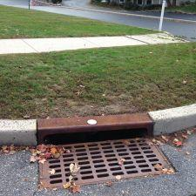
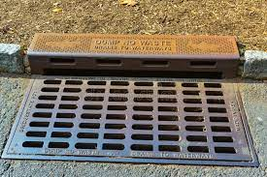
Storm Drain Inlet …
means the point of entry into the storm drain system and is, where a catch basin is present, the uppermost portion (or cover) of a catch basin.

Slide 4
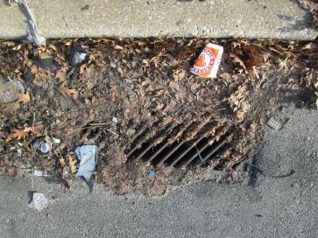
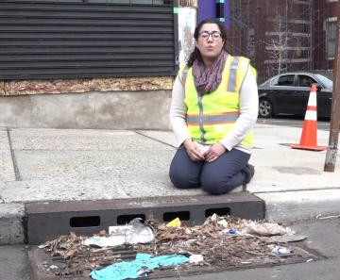
Storm Drain Inlet Inspection and Cleaning
The permittee shall inspect, at a minimum of once per year, all storm drain inlets that it owns or operates
The permittee shall develop, update, and implement a storm drain inlet cleaning and maintenance program. The program shall establish the conditions under which a storm drain inlet must be cleaned, and maintenance performed. Cleaning and maintenance shall be conducted, at a minimum, as frequently as necessary to ensure that sediment, trash, or other debris is removed as necessary to restrict it from entering the waters of the State; to eliminate recurring problems; and maintain proper function

Slide 5
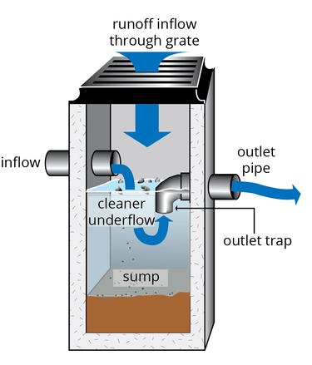
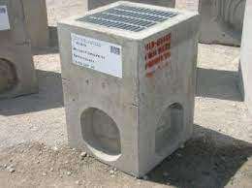
Catch Basin …
is a cistern, vault, chamber or well that is typically built along a street and below an inlet grate as part of the storm sewer system that is designed to capture and retain sediment, debris, and pollutants so those particles do pass on to the stormwater sewer system.

Slide 6
Catch Basin Inspection and Cleaning
The permittee shall inspect all catch basins that it owns or operates. At a minimum, permittees who own or operate less than 1,000 catch basins shall inspect them once per year. Permittees who own or operate 1,000 or more catch basins shall inspect a minimum of 20% of the total or 1,000 per year, whichever is greater, rotating the schedule in such a way that all catch basins are inspected at least once every five years on approximately the same frequency
The permittee shall develop, update, and implement a catch basin cleaning and maintenance program. The program shall establish when a catch basin must be cleaned and maintained and include procedures for cleaning and maintenance. Cleaning and maintenance shall be implemented as frequently as necessary to ensure, at a minimum, that sediment, trash, or other debris is removed as necessary to control it from entering the waters of the State; to eliminate recurring problems; and maintain proper function

Slide 7
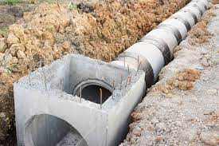
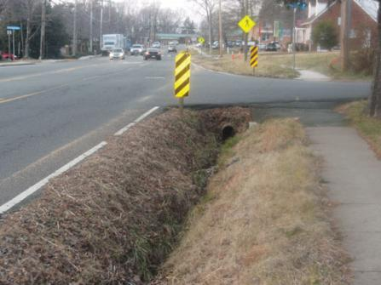
Municipal Separate Storm Sewer or MS4 Conveyance …
means a conveyance or system of conveyances (including roads with drainage systems, municipal streets, catch basins, curbs, gutters, ditches, manmade channels, or storm drains)

Slide 8
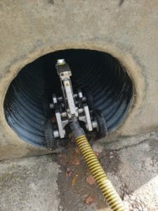
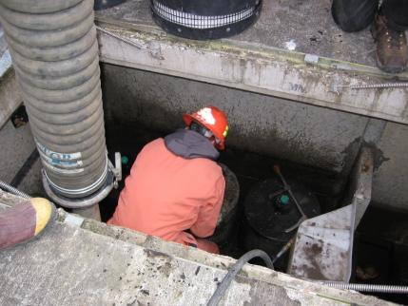
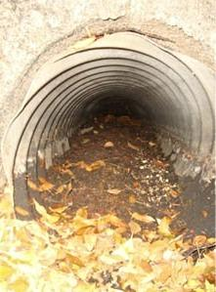
MS4 Conveyance Inspection and Cleaning
The permittee shall develop, update, and implement a MS4 conveyance inspection, cleaning, and maintenance program. The program shall establish when the MS4 conveyance must be cleaned and maintained to ensure proper function and operation;

Slide 9
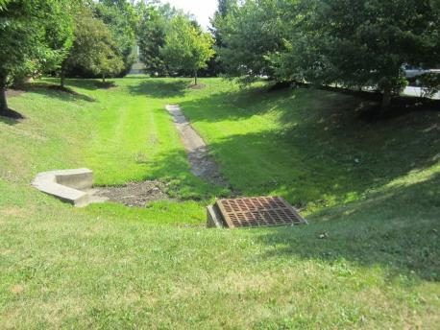
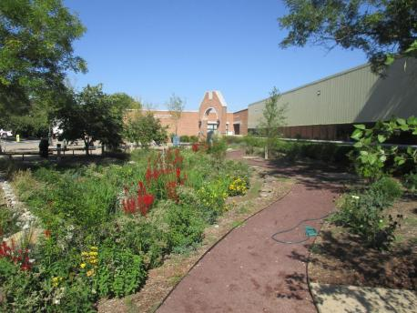
Stormwater Facility …
means stormwater infrastructure including, but not limited to, catch basins, infiltration basins, detention basins, green infrastructure, filter strips, riparian buffers, infiltration trenches, sand filters, constructed wetlands, wet basins, bioretention systems, low flow bypasses, and stormwater conveyances.

Slide 10
Stormwater Facility Inspection and Maintenance
The permittee shall inspect all stormwater infrastructure that it owns or operates pursuant to approved maintenance plans. If there are no approved maintenance plans for certain stormwater infrastructure, the permittee shall inspect that infrastructure at least 4 times annually, and after each rainstorm exceeding 1 inch of total rainfall, unless the NJ Stormwater BMP Manual recommends a less frequent schedule;
Stormwater Infrastructure Maintenance: The permittee shall perform maintenance pursuant to approved maintenance plans, or more frequently as needed, to ensure the proper function and operation. See www.njstormwater.org; for maintenance guidance;

Slide 11
Corrective Measures – Actions to be taken
If stormwater facilities are found not to be functioning properly, corrective maintenance and repairs shall be completed as soon as practicable, but no later than 90 days from discovery, unless another timeframe is authorized by the Department. The permittee shall prioritize these activities based upon environmental, health and safety concerns

Slide 12
Maintenance Logs, Inspection Reports, and Certification
The permittee shall maintain a log, including but not limited to the type of stormwater facility; location information of the facility with geographic coordinates; name of inspector; date of inspection; observations of the structural integrity; history of complaints; evidence of current or previous flooding; any preventative and corrective maintenance performed; and any additional information or findings. Example Maintenance Logs and Inspection Records forms are available at www.njstormwater.org under the maintenance guidance link;
The permittee shall certify in the MSRP Annual Report whether or not municipally owned or operated stormwater facilities have been inspected, are properly maintained, and are properly functioning.

Slide 13
Stormwater Inlet Inspections
What to look for?
Is the grate clear to allow flow into the catch basin? Does it need to be cleaned?
What to log?
What type of inlet is it
Is the inlet labeled
Does the inlet meet the standards

Slide 14
Catch Basin Inspections
What to look for?
Does the catch basin need to be cleaned of excessive sediments?
Is the catch basin structurally stable or is it in need of repair?
What to log?
Depth of catch basin
Size of inflow outflow pipes
Amount of sediment

Slide 15
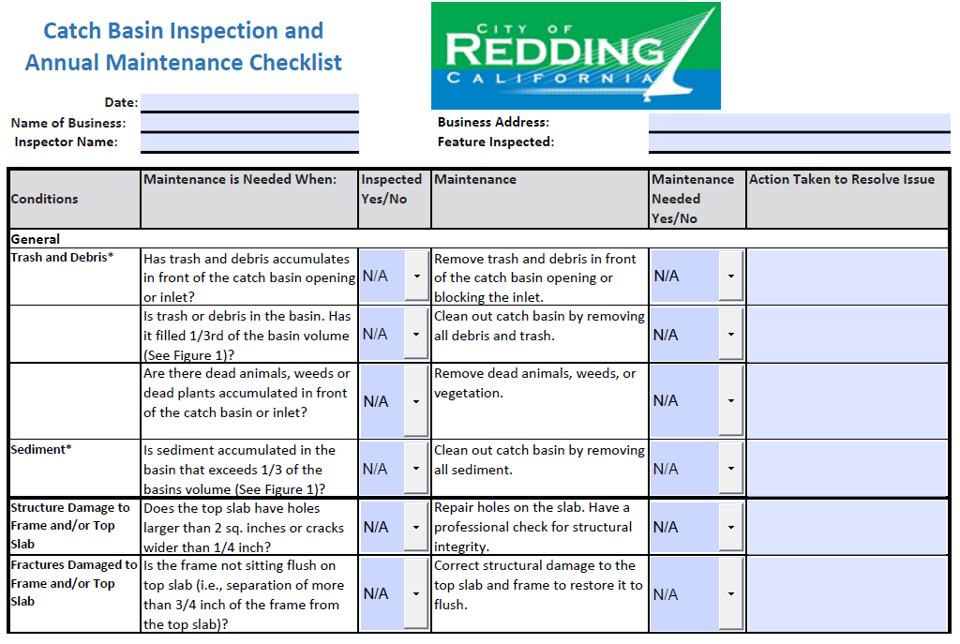

Slide 16
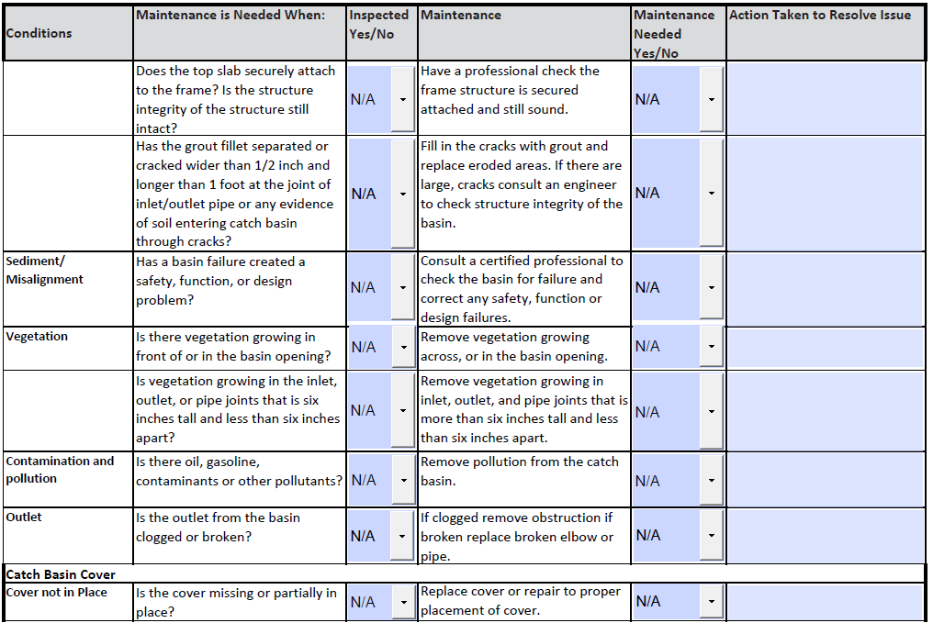

Slide 17
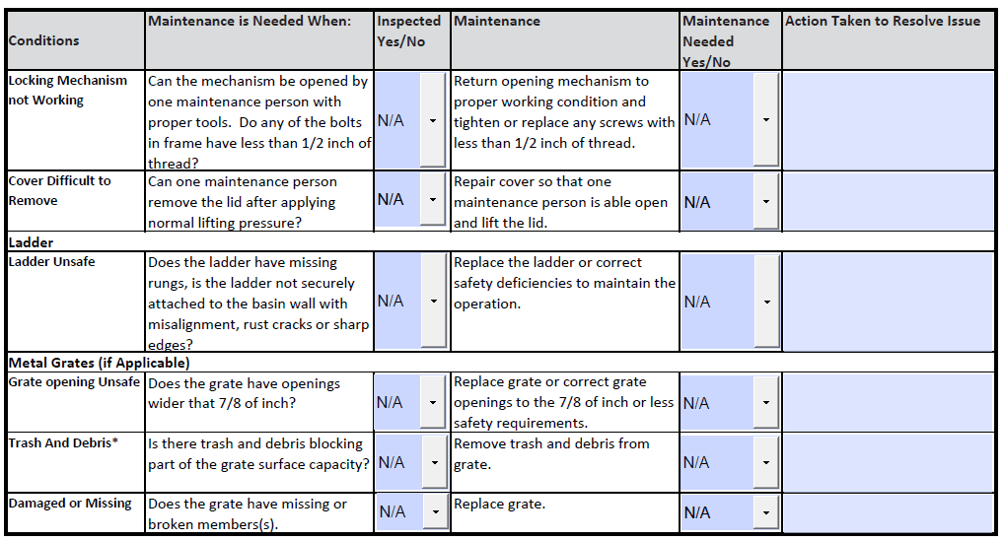

Slide 18
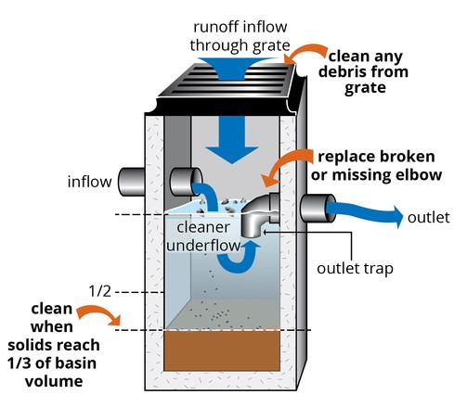
Stormwater Inlet and Catch Basin Maintenance
Clear vegetation or debris from basin surface
Collect sediment from basin with vacuum truck
Repair damaged structures
(portland.gov)

Slide 19
Stormwater Basin Types
Detention
Retains and slowly releases stormwater completely
Retention
Permanently retains water to allow settling while still providing detention
Infiltration
Outlet orifice is raised to allow portion of stormwater to infiltrate into the ground. Provides detention during larger storm events.

Slide 20
What is a Detention Basin?
Detention basins are designed to detain stormwater runoff during a storm and slowly release the stormwater after the storm.
Prevents downstream flooding
Removes pollutants only through settling
Typically goes dry 48-hours after storm
Usually contains turf grass that is regularly mowed
Often contain concrete low-flow channel
Follow old regulation standard
(rivanna-stormwater.org)

Slide 21
Typical Detention Basin

Slide 22
Typical Detention Basin

Slide 23
What is a Retention Basin?
(a.k.a. stormwater ponds, wet retention ponds, wet ponds)
Retention basins maintains permanent pools and stores stormwater runoff on tope of existing standing water.
Prevents downstream flooding
Removes pollutants mainly through settling and algal uptake
Always has a minimum of three feet of standing water
Often attract lots of geese
Can require dredging
(rivanna-stormwater.org)

Slide 24
Typical Detention Basin

Slide 25
Typical Retention Basin

Slide 26
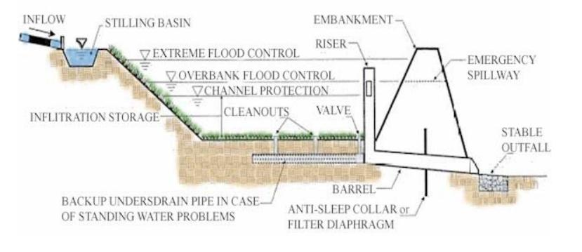
What is an Infiltration Basin?
Infiltration basins have a raised outlet structure to allow infiltration with the intention of the system fully draining
Prevents downstream flooding
Removes pollutants through infiltration
Typically dry 48 hours after storm
Follow more modern regulation standards, but now largely replaced by bioretention systems (similar but with vegetation)
(stormwaterpa.org)

Slide 27
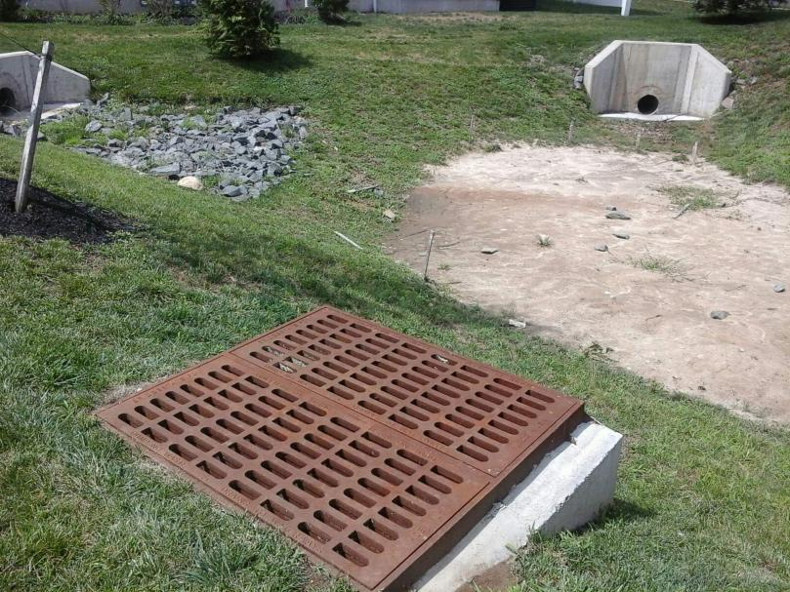
Typical Infiltration Basin

Slide 28
Stormwater Facilities Inspections
Inspection Frequency
Pursuant to approved maintenance plans
OR, if there are no approved maintenance plans for certain stormwater infrastructure, the permittee shall inspect that infrastructure at least 4 times annually, and after each rainstorm exceeding 1 inch of total rainfall, unless the NJ Stormwater BMP Manual recommends a less frequent schedule

Slide 29
What to look for?
Is there erosion of the side slopes, basin bottom, or shoreline?
Is there sediment accumulation in the forebay or basin?
Are the inlets and outlet devices free of debris and operational?
Is the concrete low-flow channel clogged or broken?
Is there standing water (detention or infiltration basin)?
Is the evidence of nutrient enrichment (retention basin)?
Are there floatables accumulated in the basin?
Is the grass healthy? Are there bare spots? (detention basin)
Are there undesirable weeds or woody vegetation? (detention or retention)
Is there evidence of geese?
Is there a healthy vegetative buffer? (retention basin)

Slide 30
Who does inspections?
MS4 Permit requires municipalities to ensure that all stormwater facilities (public and private) are being maintained and operating as designed.
Municipality inspects public facilities
Municipality require private facilities to be inspected by a stormwater professional
Annual inspection reports are required

Slide 31
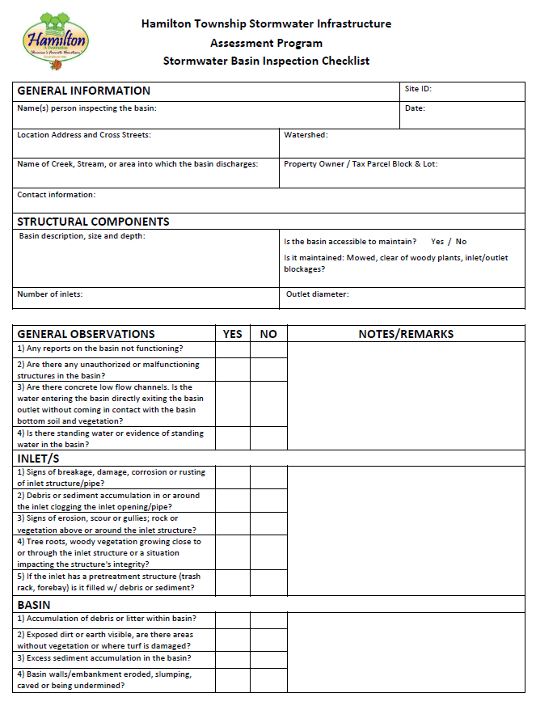
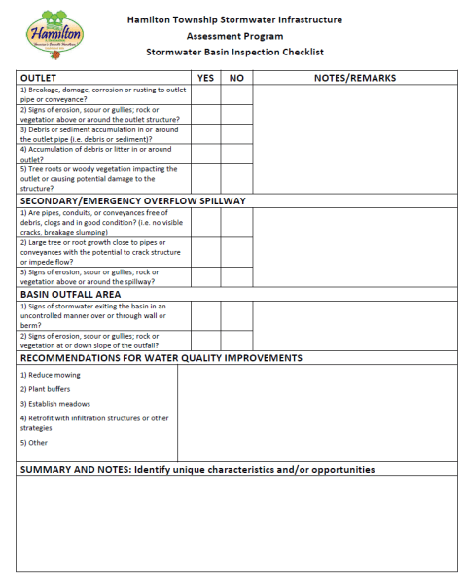
Example Inspection Form for Detention Basins

Slide 32
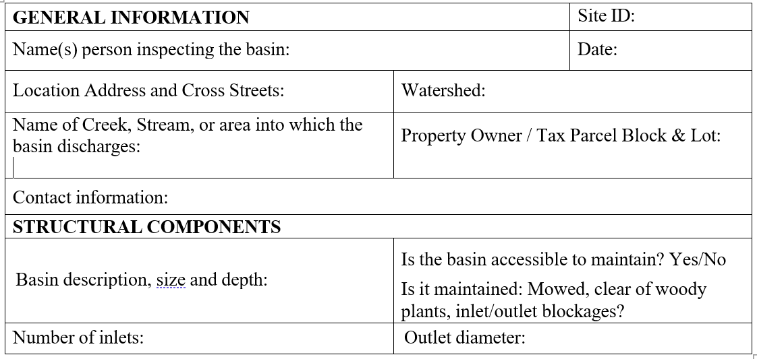

Slide 33
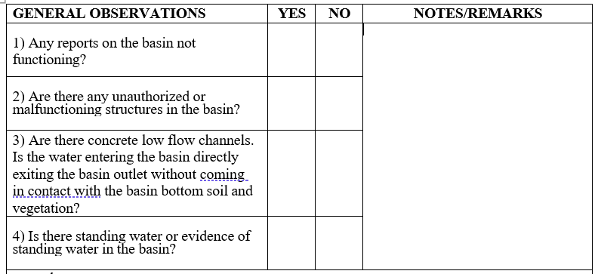

Slide 34
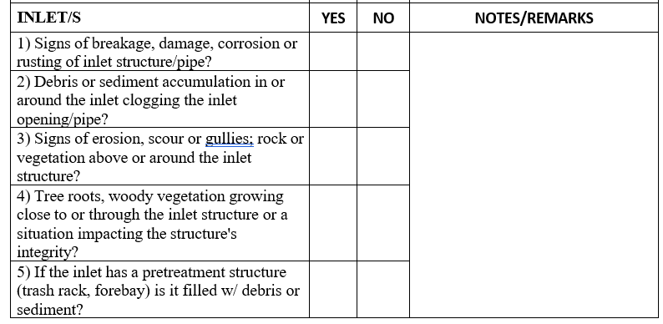

Slide 35
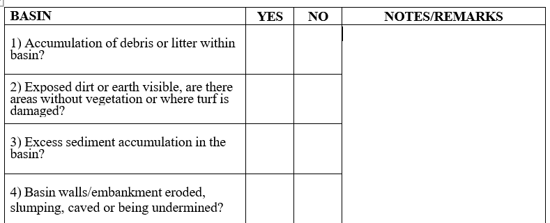

Slide 36
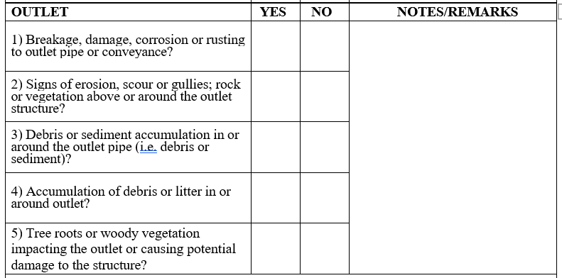

Slide 37
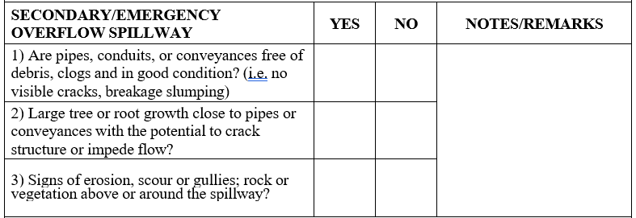

Slide 39
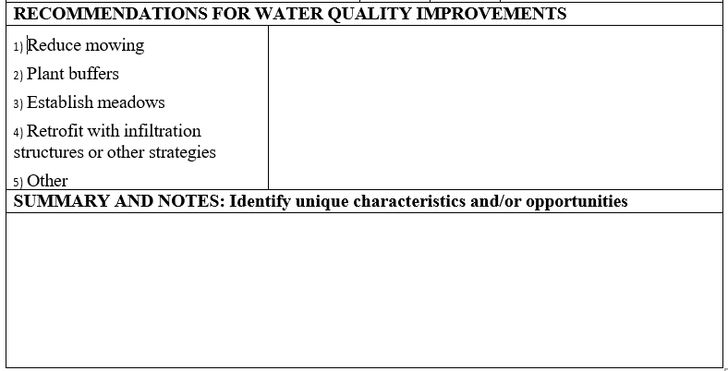

Slide 40
Types of Maintenance
Routine Maintenance
Vegetation management
Debris and litter removal
Mechanical components maintenance
Non-Routine Maintenance
Stabilization and erosion control repairs
Sediment removal
Outlet repair or replacement

Slide 41
Routine Maintenance

Slide 42
Routine Maintenance Requirements
Vegetation management
Mowing should be done where/when it is needed (traditionally, 10 - 14 times per year)
Effective groundcovers must be kept healthy to prevent erosion and damage to the system
Debris and litter removal
Inlets and outlets should be regularly cleared of debris and litter to prevent obstructions and reduced efficiency of the system
Mechanical components maintenance
All mechanical equipment, such as gates, valves, locks, or other components must be kept in working order should an emergency arise

Slide 43
Routine Maintenance

Slide 44
Routine Maintenance for
Mechanical Components
– Regular inspections will reduce need for major replacements

Slide 45
Non-Routine Maintenance

Slide 46
Non-Routine Maintenance
Stabilization and erosion control repairs
If vegetation fails on embankments or in the basin, soil replacement, reseeding and stabilization should occur immediately
Sediment removal
Excessive sediment accumulated in the basin should be removed.
Outlet repair or replacement
Should the system stop functioning as designed the outlet structure may require repair or replacement

Slide 47
Non-Routine Maintenance

Slide 48
Outlet Repair or Replacement
Conduct regular inspections to ensure system is functioning properly and debris and litter are not clogging the outlet
Provide and maintain clear access to all structures of the system

Slide 49
QUESTIONS?
Rutgers Cooperative Extension Water Resources Program
Chris Obropta
Email: obropta@envsci.rutgers.edu
Matt Leconey
Email: matthew.leconey@rutgers.edu
www.water.rutgers.edu

