Slide 1
A Rain Garden Rebate Program Save Barnegat Bay NEMO Program
Rutgers Cooperative Extension Water Resources Program
Chris Obropta

Slide 2
Overview
What happens when it rains?
Statement of the problem
Existing development and impervious cover
The solution – rain gardens
The Rain Garden Rebate Program

Slide 3
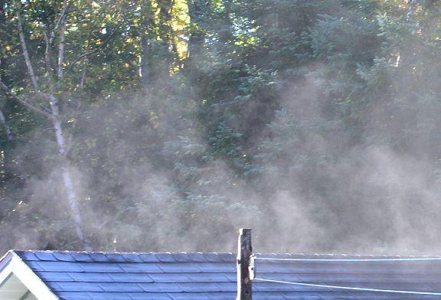
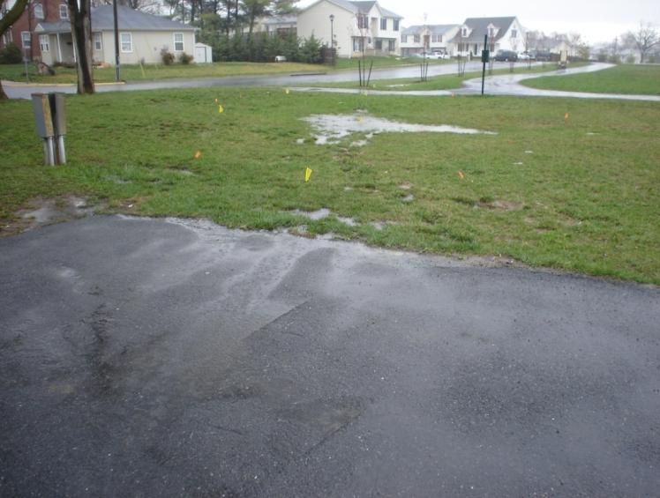
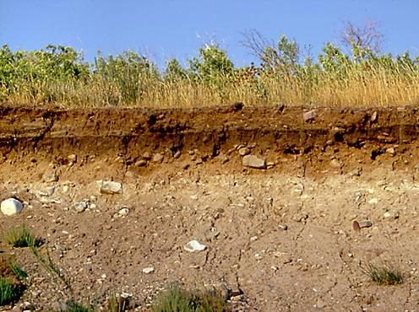
What happens to the rain in our watersheds?
It infiltrates into soils…
It runs off of rooftops and pavement…
It evaporates…
It is absorbed by plants…

Slide 4
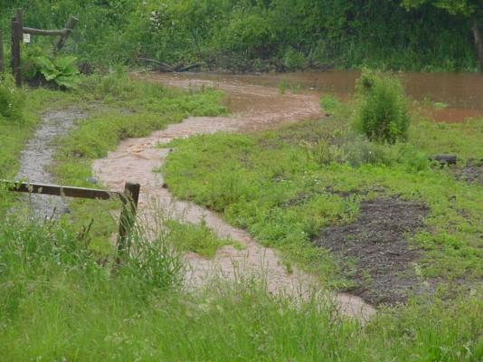
What is stormwater runoff?
Stormwater is the water from rain or melting snows that can become “runoff,” flowing over the ground surface and returning to lakes and streams.

Slide 5
Statement of Problem
Stormwater runoff from existing development is destroying the health of our waterways and causing localized flooding.

Slide 6
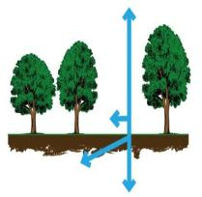
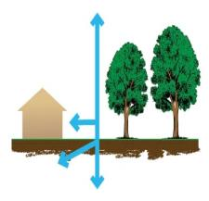
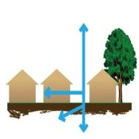
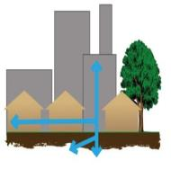
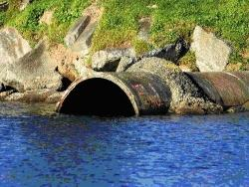
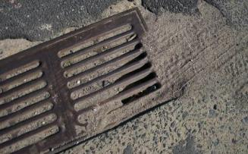
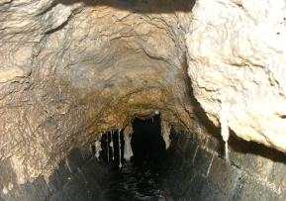
The Impact of Development on Stormwater Runoff
30%
55%
10%
20%
more development
More impervious surfaces
more stormwater runoff

Slide 7
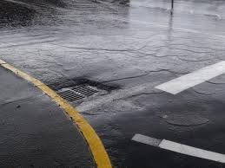
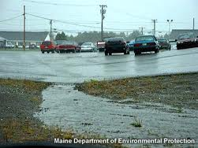
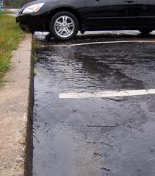
To minimize impact of stormwater runoff, you must control runoff from impervious surfaces

Slide 8
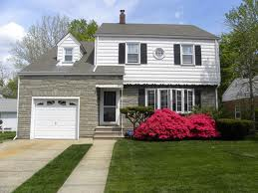
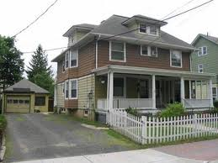
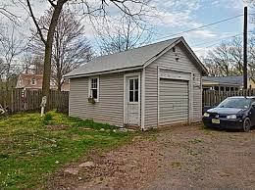
Lots of impervious surfaces

Slide 9
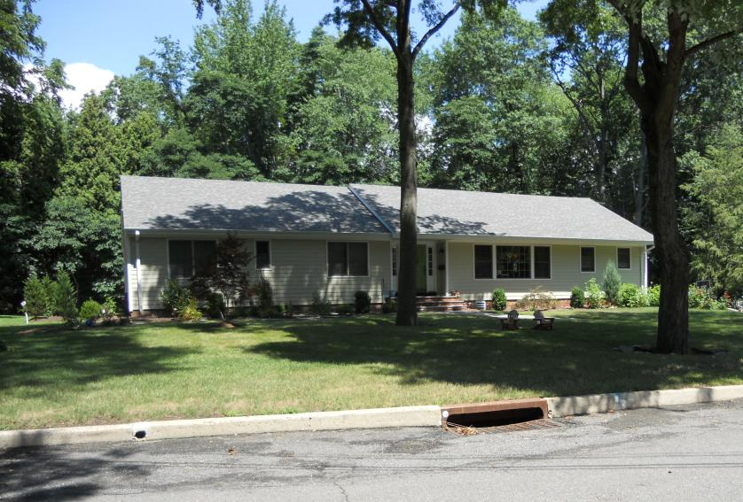
Connected or Disconnected?

Slide 10
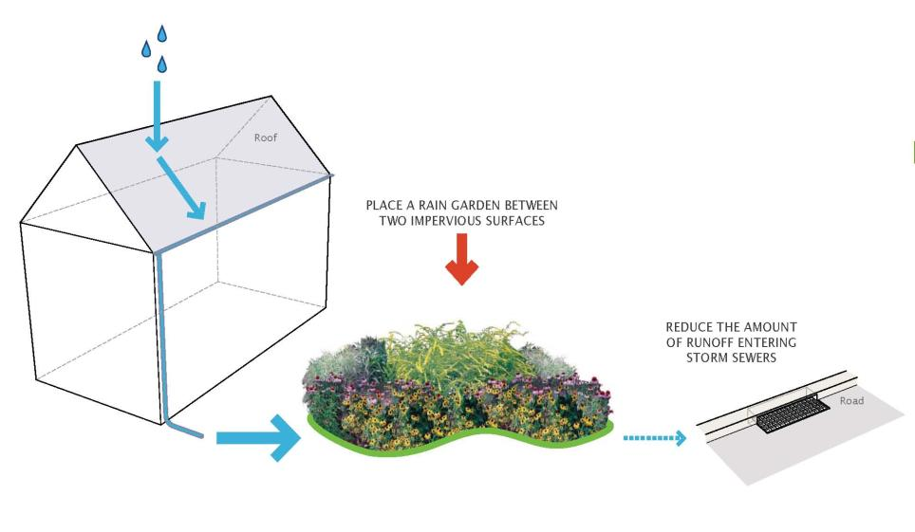
Part of the Solution
Install a rain garden

Slide 11
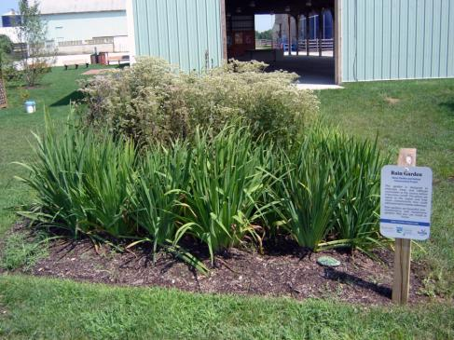
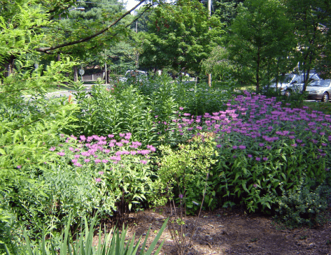
Rain Gardens
A rain garden is a landscaped, shallow depression that is designed to capture, treat, and infiltrate stormwater at the source before it becomes runoff.
Notes:
What is a rain garden?

Slide 12
Notes:
The Blue House Picture. Before and after a roadside rain garden. Talk about increasing property value!

Slide 13
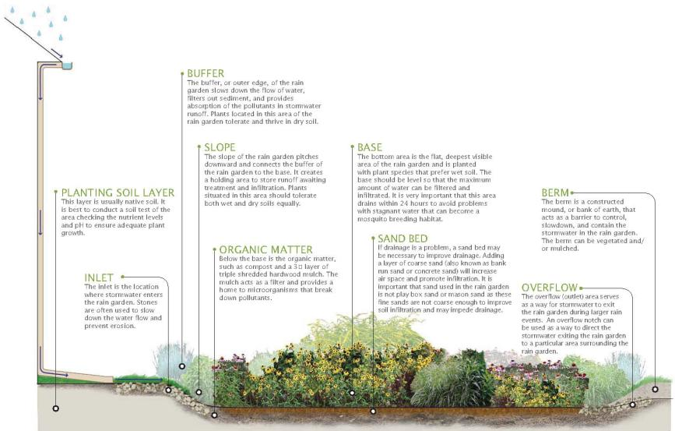
Parts of a Rain Garden

Slide 14
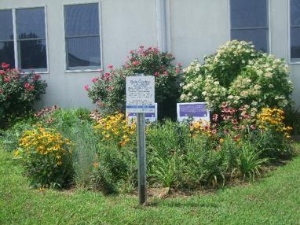
Rain Gardens
Landscaped areas that treat stormwater runoff
Designed to merge two important goals: aesthetics and water quality
Can be blended into the landscape and made to look natural
Water is directed into them by pipes, swales, or curb openings
Notes:
More about rain gardens.

Slide 15
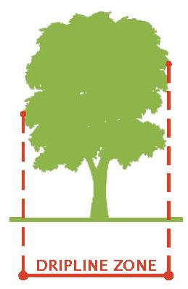
Site Selection
Next to a building with a basement, rain garden should be located at a minimum of 10′ from building; no basement, 2′ from building
Do not place rain garden within 25′ of a septic system
Do not situate rain garden in soggy places where water already ponds
Avoid seasonably-high water tables within 2′ of rain garden depth
Consider flat areas first – easier digging
Avoid placing rain garden within dripline of trees
Provide adequate space for rain garden
Notes:
Siting considerations.

Slide 16
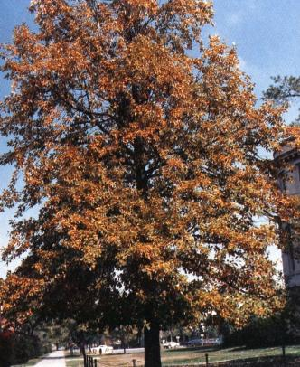
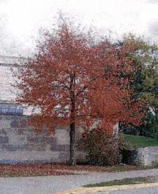
Native Vegetation
Notes:
We plant our rain garden with native plants.

Slide 17
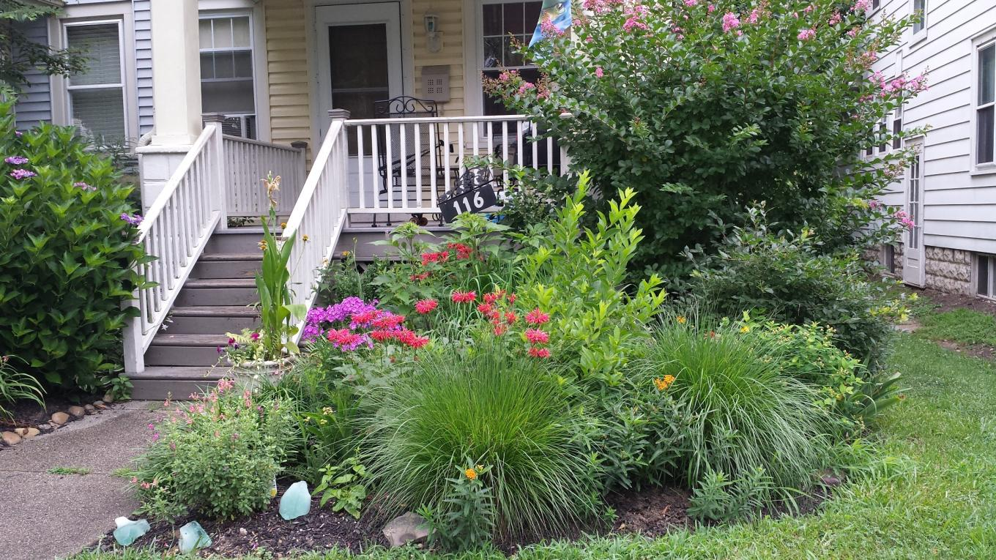
Notes:
Can be incorporated into the landscapes of individual homes

Slide 18
How do we get people to install rain gardens?
By providing incentives and technical assistance to homeowners
The Rain Garden Rebate Program

Slide 19
Rebate Program Details
One educational session (45 minutes)
One-on-one technical sessions with designer (30 minutes per homeowner)
Leaves technical session with a plan
Rebates of $3 per square foot of garden or more
Inspections of completed gardens

Slide 20
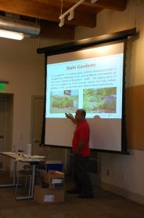
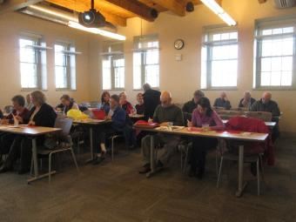
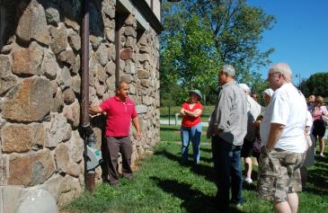
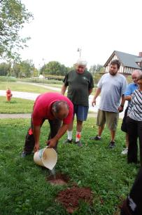
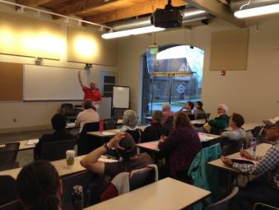
Educational Sessions
Photo courtesy of: NJWSA
Photo courtesy of: NJWSA
Photo courtesy of: NJWSA

Slide 21
Take Home Handouts

Slide 22
Check Your Soil Infiltration/Percolation Test
Dig a hole in the proposed rain garden site (12” deep, 4-6” wide)
Fill with water to saturate soil and then let stand until all the water has drained into the soil
Once water has drained, refill the empty hole again with water so that the water level is about 1” from the top of the hole
Check depth of water with a ruler every hour for at least 4 hours
Calculate how many inches of water drained per hour

Slide 24
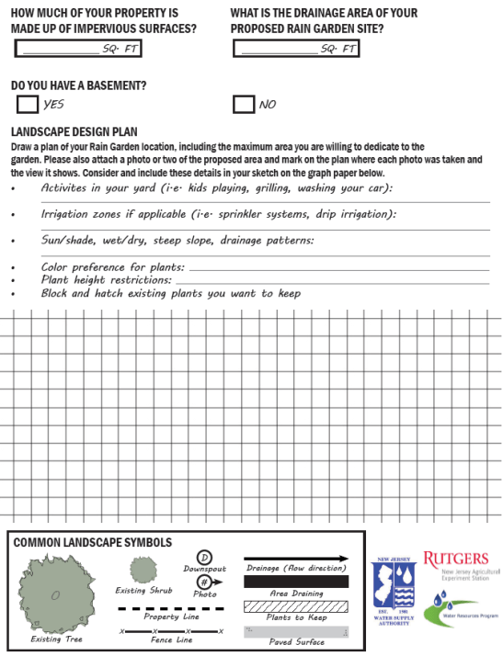

Slide 25
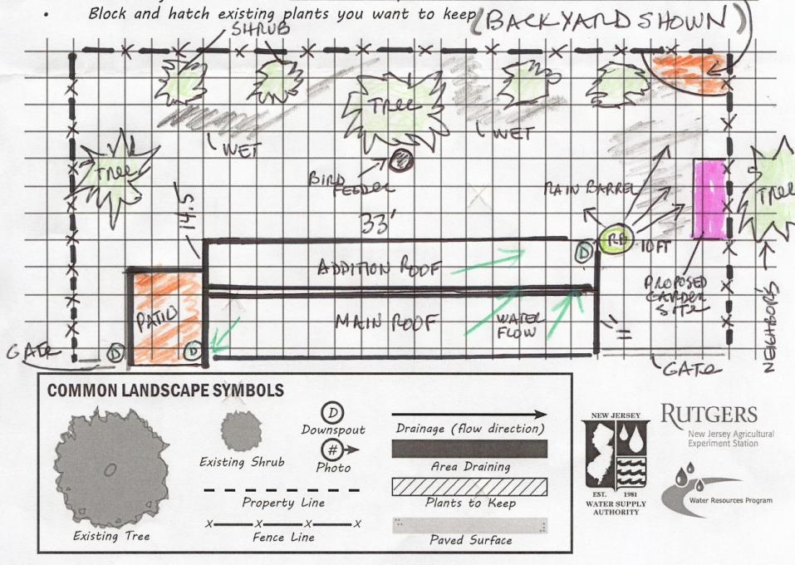

Slide 26
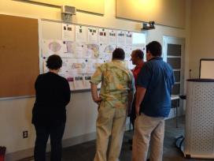
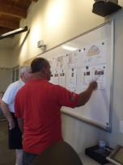
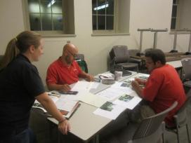
Technical Support Sessions

Slide 27
Rebate Program Summary
Must attend an educational workshop
Attend a technical session with a rain garden designer
Native plants are preferred. Installed plants must not be an invasive species
Renters need a signed written agreement from the homeowner/property manager prior to participation
Participants must pledge to maintain their rain garden for at least five (5) years

Slide 28
Rebate Summary
All rain gardens installed must pass inspection
$3 per square foot of rain garden (some programs offer more)
up to $450 per property
Minimum size: 25 square feet

Slide 29
Examples of Rebate Designs and Installations

Slide 30
125-Roof Runoff
Design
Installed Rain Garden

Slide 31
8-Roof, Sump Pump and Driveway Runoff
Design
Installed Rain Garden

Slide 32
966-Roof Runoff
Design
Installed Rain Garden

Slide 33
406-Driveway Runoff
Design
Rain Garden Installed

Slide 34
5-Driveway Runoff
Design
Installed Rain Garden

Slide 35
240-Roof Runoff
Design
Installed Rain Garden

Slide 36
23-Garage Roof Runoff and Rain Barrel Overflow

Slide 37
Some Lessons Learned
Design assistance was a primary influence for individuals to install a rain garden not the rebate!
Local projects integrated into the educational program appears to increase participation (limit technical information and show examples!)
Need to find assistance for those unable to physically do it themselves

Slide 38
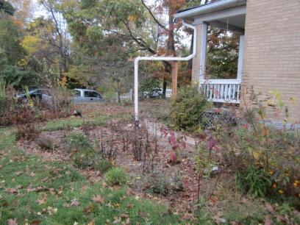
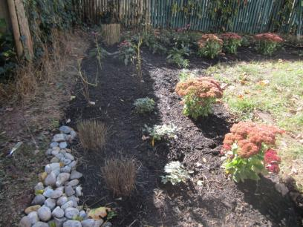
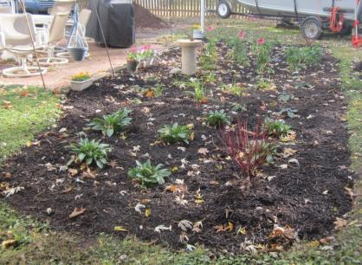
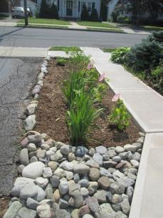
Notes:
2013 Attendees

Slide 39
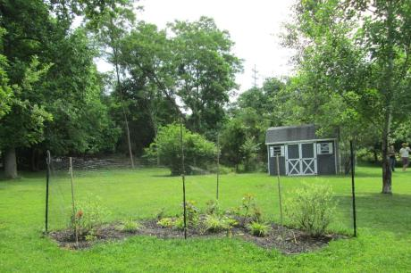
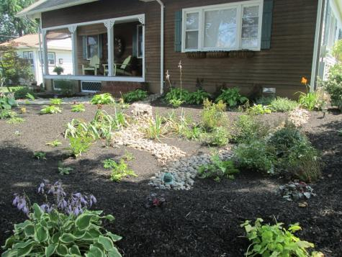
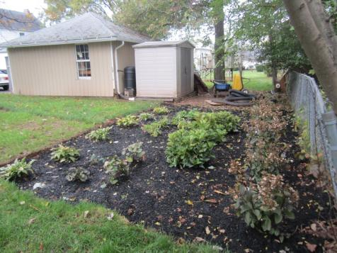
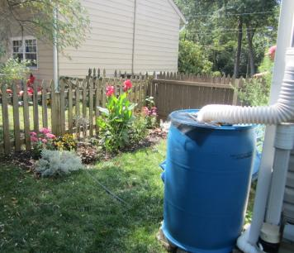
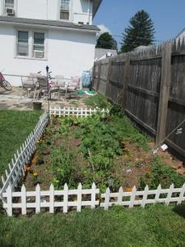
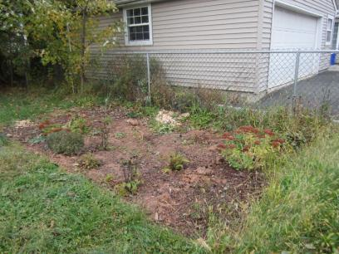
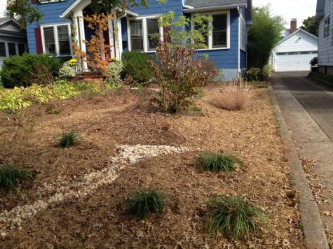
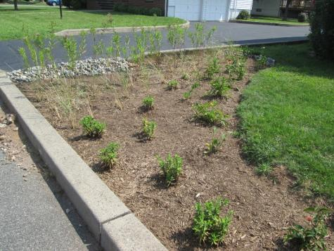
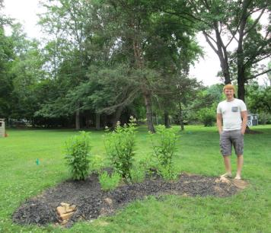
Notes:
2014 Attendees

Slide 41
Additional Resources

Slide 42
Here is the website for the rain garden manual: http://www.water.rutgers.edu/Rain_Gardens/RGWebsite/RainGardenManualofNJ.html
Notes:
We have a rain garden manual that is available for download from our website.

Slide 43
Notes:
We worked with UCONN to develop a rain garden app for New Jersey.

Slide 44
Christopher C. Obropta, Ph.D., P.E. E-mail: obropta@envsci.rutgers.edu www.water.rutgers.edu

